Slide 1
Teacher Engagement Ambassador Program (TEA)
An Evaluation of the impact, intangible benefits, and Roi
2021-2022

Slide 2
TEA Program Overview
Social and emotional support to newly-hired teachers in schools with higher teacher turnover rates (Title I mostly).
Teacher Engagement Ambassadors = experienced teachers provide support to new teachers at their school site
Support includes monthly check-ins, face-to-face meetings, visits to their classroom, emails, postcards, gifts, etc.
2021/2022: 30 Participating Schools

Slide 3
Why the TEA Program?
Good communication with Program Leaders = More access to information
Data-based program = Data already collected with validated instruments
Relatively expensive program
Topic addressing an important issue: Teacher Recruitment and Retention
When selecting the program, we analyzed potential limitations to the information and challenges along the way.
Notes:
There were several factors analyzed when we selected the program, first was the understanding that we have good communication with the program leaders. This team is very responsive to emails, willing to provide us any information requested, and available to meet frequently and answer questions. The second reason was related to the data they collect. We were aware they are a data-based program which was helpful for us. We did not have to collect any new data because they conduct teacher surveys with program participants and control groups, and they track their teacher positions and vacancies monthly. The other factors were related to the cost of the program and the importance of the topic. This is a relatively expensive program, costs yearly around the 150 thousand dollars, and teacher recruitment and retention is an important topic not only for Polk, but at the state and national level. Which in turn becomes also a precaution! Because is highly political and we were aware that we needed to be very transparent on the process and decision-making.

Slide 4
Evaluation model: data levels and objectives
L1. REACTION & PLANNED ACTION
High levels on Workplace PERMAH Profiler
L2. LEARNING
High levels on Connor-Davidson Resilience Scale
L3. IMPLEMENTATION
All Teacher Engagement Ambassadors communicate with newly hired teachers
L4. PROGRAM IMPACT
Retention rates increase in all TEA Schools
L5. ROI
TEA has a 0% ROI
Notes:
As mentioned previously, the program currently collects data from different sources. They use instruments that are validated by the research community, like the PERMAH Profiler and the Connor Davidson Resilience Scale. The also have accountability logs for the ambassadors to complete anytime they interact with a new teacher at the school. and also they track their retention rates monthly. All this data allowed us to gather information from all levels, from the reaction and planned action all the way to the program impact.

Slide 5
ROI Calculation
Net Program Benefits (3 Steps)
ROI (%)
100
Program Costs

Slide 6
Program Benefits
1
Estimated PCPS Teacher Turnover Cost SY21/22
2
Identified the Program Effect from the comparison of historical retention data
3
Calculated the unit to be used as the monetary value
The program’s ultimate payoff is in terms of cost avoidance; that is, the estimated cost avoided by retaining newly hired teachers.

Slide 7
1
Estimated PCPS Teacher Turnover Cost SY21/22
TTCM Model: Teacher Turnover Cost Model (Synar & Maiden, 2012) and adapted to Polk County Public Schools
TTCM Model
Separation Costs
Hiring Costs
Training/Professional Development
Performance Productivity
Model adaptation to PCPS
Separation Costs
Administrative Tasks Associated with Hiring
Recruitment and Retention
Training/Professional Development
Performance Productivity

Slide 8
2
Identified Program Effect from Retention Data
Difference from 19/20 to 21/22 by school site
Average of all schools
Program Effect %

Slide 9
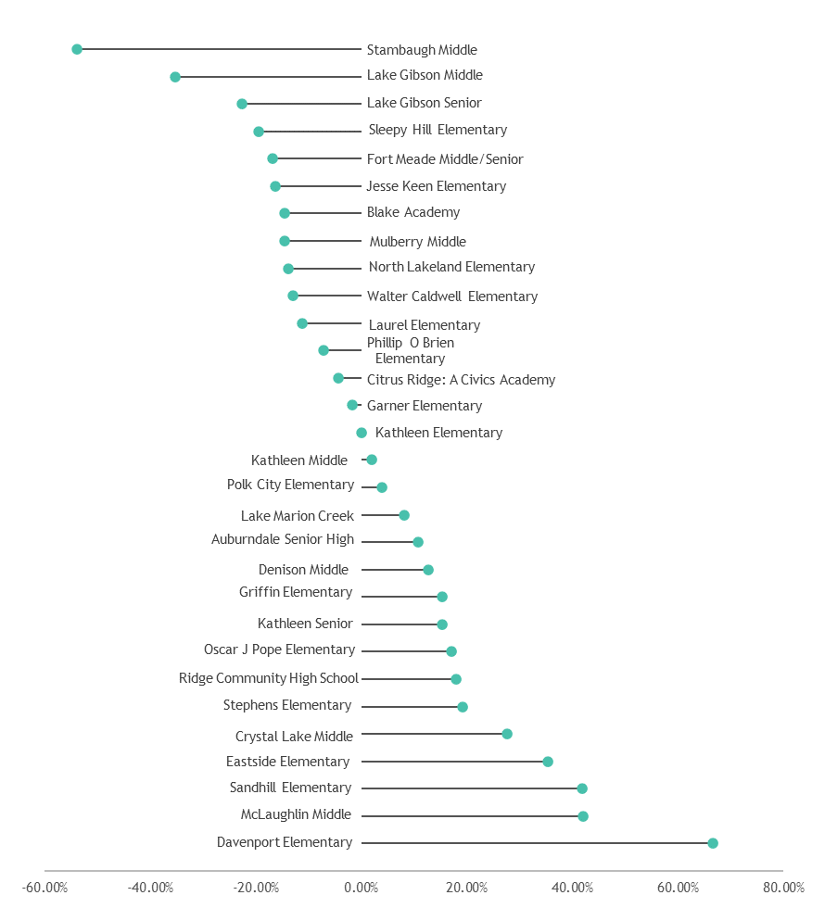
Program Effect
% Of Difference From 19/20 To 21/22
How Much Have Retention Rates Changed in Each TEA School?
The effect in TEA schools ranged from -53.95% to 66.67%, with an average of 3.06%.

Slide 10
3
Calculated the Unit to be converted into the monetary value (benefits in $$)

Slide 11
Monetary Value

Slide 12
Program Investment
Program Cost SY 21/22
Admin staff (Salary/benefits) | $ 42,924.40
Business Cards | $ 1,000.00
Supplies | $ 500.00
Stipends Paid to Ambassadors | $ 94,272.00
Third-party Contracted Services | $ 15,500.00
Total | $ 154,196.40

Slide 13
Estimated Program’s ROI
The final analysis suggests that by spending $154,196.40 in the TEA Program during SY 21/22, the district retained approximately 30 FTE units of new teachers, avoiding $277,690.93 in additional investment.
The Teacher Engagement Ambassador Program helped the district avoid spending over $277,000.00 due to teacher turnover.
It is estimated that the TEA Program returned 80% of the investment during SY 21/22, meeting and exceeding the goal of 0% ROI.

Slide 14
Intangible Benefits
Of the 62 participants who completed the survey, 98% acknowledged their ambassador communicated with them. They also rated the program as effective (4.17) in providing support and communicating with them.
More resilience, but also higher negative emotions

Slide 15
Areas for Improvement and Next Steps
Methodology
Add Participant Estimates to calculate the effect of the program.
Improve analysis of the vacancies to include the whole School Year
Next Steps
Include the full ROI Methodology in 2 projects per School Year

