Slide 1
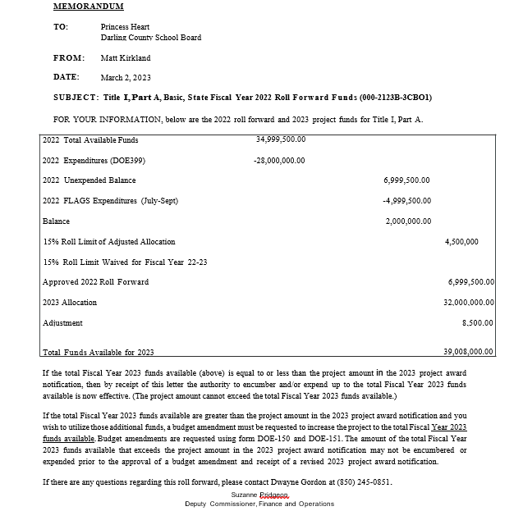

Slide 2
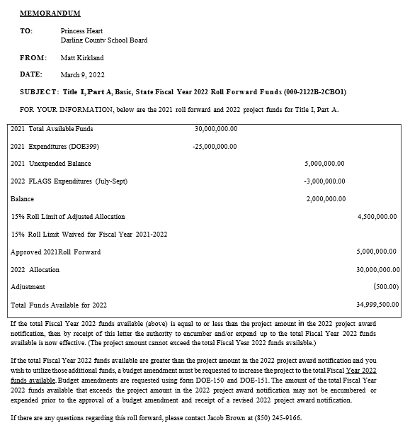
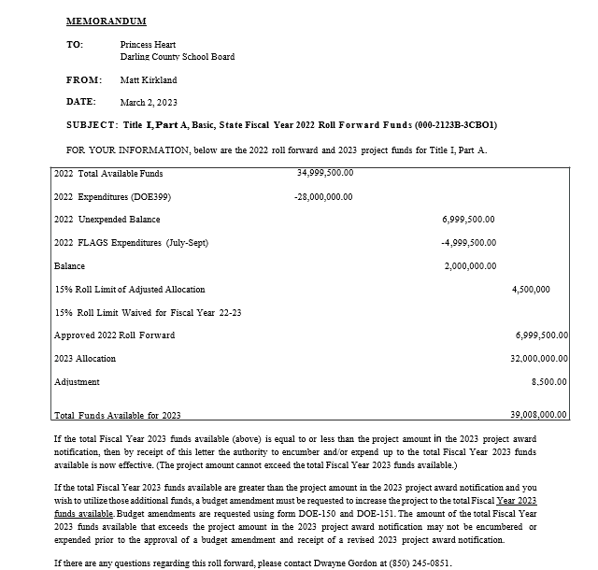
2022 Total Available Funds
This number should match the “Total Funds Available Funds for 2022” from your 2022 Certified Roll Forward Letter

Slide 3
2022 Expenditures (DOE399)
Total disbursements from the 2021-2022 Title I, Part A Grant Award. This number should match your FA399 disbursements/expenditures.

Slide 4
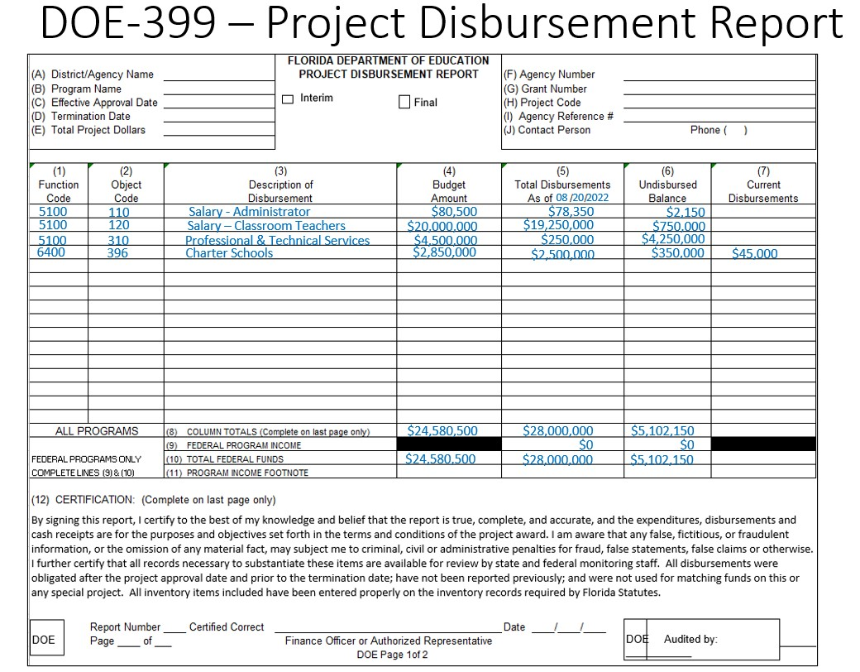

Slide 5
2022 Unexpended Balance
This number should match your FA399 undisbursed/unexpended balance from the 2021-2022 Title I, Part A Grant Award. In other words, what was not spent.

Slide 6
2022 FLAGS Expenditures (July 2022, August 2022, September 2022)
This is what was “drawn down” (expenditures reported in FLAGS) during the first three months of the 2022-2023 Title I, Part A Grant Cycle.
This consideration is a benefit for Districts because it reduces the likelihood of exceeding the 15% cap on unexpended funds from the 2021-2022 Title I, Part A Grant Award.

Slide 7
Balance
To determine whether the 15% roll forward cap was exceeded, the “draw down” for expenditures in July, August, and September are subtracted from the 2021-2022 Title I, Part A Grant Award undispersed/unexpended balance on your FA399.
2022 Unexpended Balance
2022 FLAGS Expenditures (July-Sept)
Balance

Slide 8
15% Roll Limit of Adjusted Allocation
This number represents 15% of your 2022 Allocation from the 2021-2022 Title I, Part A Grant Award.

Slide 9
15% Roll Limit Waived for Fiscal Year 22-23 –
If the “Balance” is LESS THAN the “15% Roll Limit of Adjusted Allocation”, this line will be blank.
If the “Balance” is MORE THAN that “15% Roll Limit of Adjusted Allocation”, there will be an “X”.
If the District has exceeded the 15% cap, review/verify your July 2022, August 2022, and September 2022 expenditures at the local level for accuracy.
You are invited to reach out to the ECTAC team to review Roll Forward calculations and requirements for a waiver.

Slide 10
Approved 2022 Roll Forward
This is the amount of unexpended 21-22 funds the district is approved to roll into the 22-23 school year. We believe this amount should be the unexpended/undispersed balance on your FA399 from the 2021-2022 Title I, Part A Grant Award.

Slide 11
2023 Allocation –
We believe that what was on the Certified Roll Forward letter was the 2021-2022 Title I, Part A Final Allocation. (This is what was included as a “preliminary allocation” in the 2022-2023 Grant Application.)
To date, Districts have not been provided a current year, preliminary allocation for the 2022-2023 school year.

Slide 12
Adjustment – This reflects an increase or decrease in funding from the Preliminary Allocation to the final allocation.
Final Allocation provided by FDOE (not received to date)
- Allocation Amount provided in the 2022-2023 Application (without Roll Forward) .
Adjustment

Slide 13
Total Funds Available for 2023 – This number helps you determine if a Title I, Part A budget amendment is needed.
Is your most recent “Total Project Amount” Project Award Notification MORE or LESS than the “Total Funds Available for 2023”?
LESS: If the total Fiscal Year 2023 funds available (above) is equal to or less than the project amount in the 2023 project award notification, then by receipt of this letter the authority to encumber and/or expend up to the total Fiscal Year 2023 funds available is now effective. (The project amount cannot exceed the total Fiscal Year 2023 funds available.)
MORE: If the total Fiscal Year 2023 funds available are greater than the project amount in the 2023 project award notification and you wish to utilize those additional funds, a budget amendment must be requested to increase the project to the total Fiscal Year 2023 funds available. (Amendments are due on or before 4/20/2023)

