Slide 1
Fairlawn Elementary
Magnet School
K-5
Fort Pierce, Florida
1949-2018
We are FAIRLAWN for a reason.

Slide 2
One School
One Goal

Slide 3
Standards Based Instruction
After the unpacking…….
A time for (a schedule) change…
Collaborative Planning……
Backward design……
Reflection…..

Slide 4
STUDENTS
Know where they are..
Meet them there…
Move forward with precision focus…
Celebrate success!

Slide 5
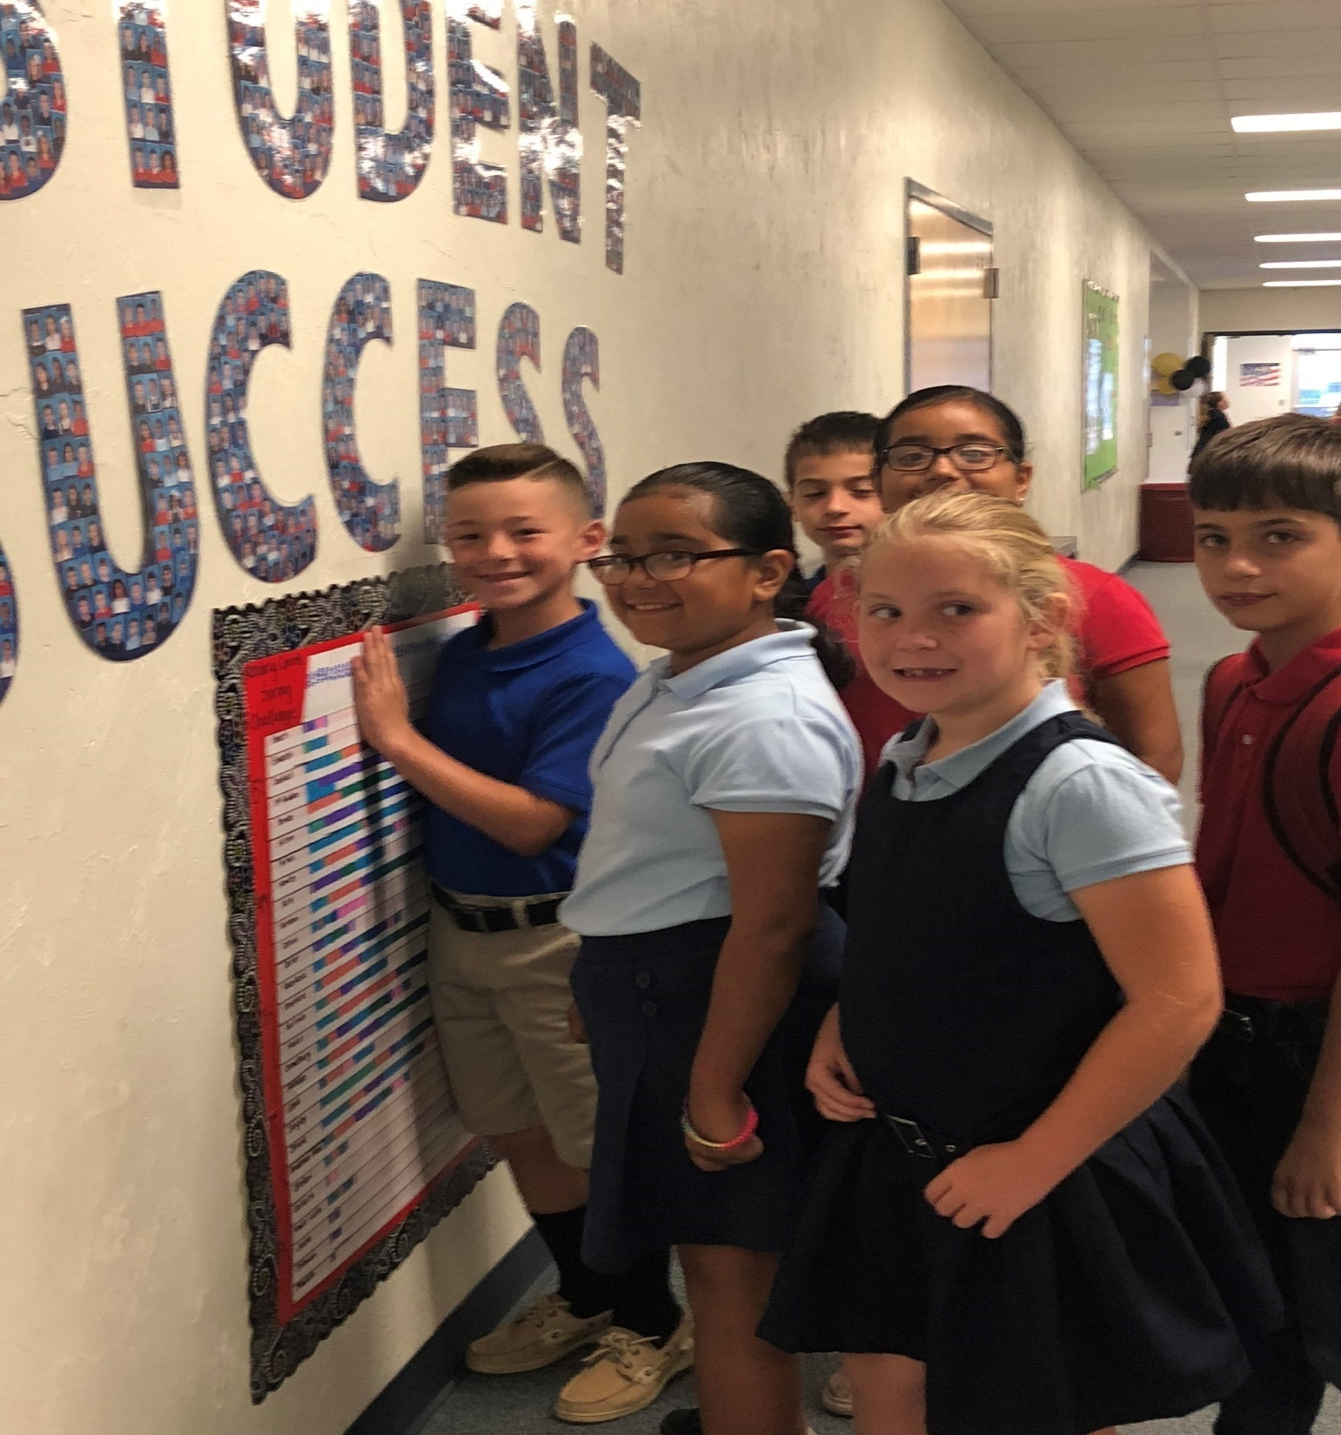

Slide 6
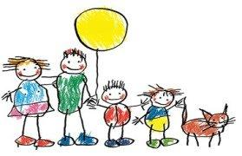
Know Your Students (and their families!)
A child can’t learn if they are hungry, tired, afraid, etc….
We help families link to community services in times of need.
The Fairlawn Family supports one another and our community.

Slide 7
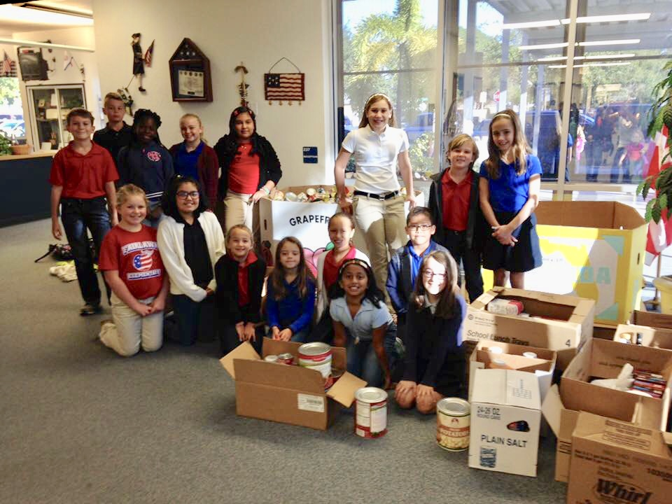
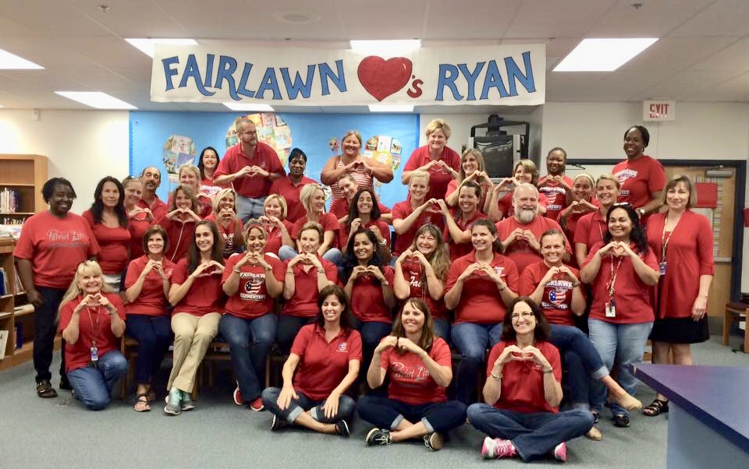
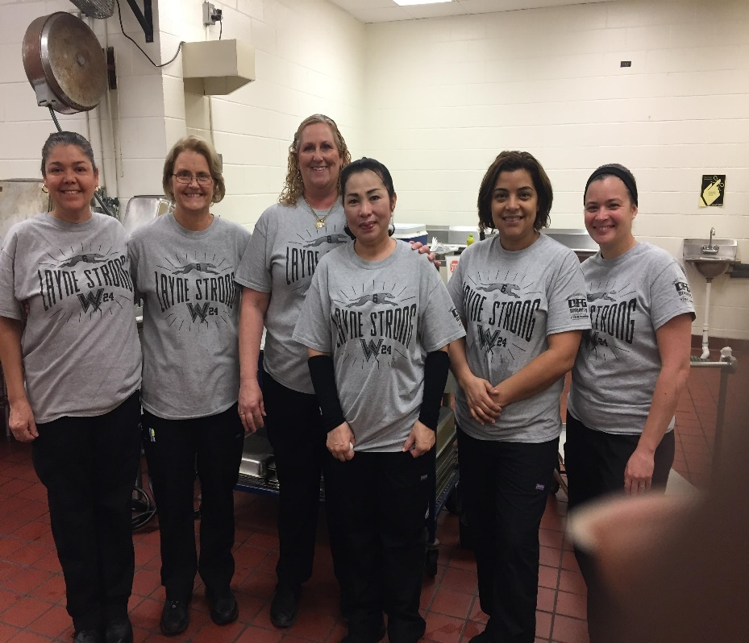
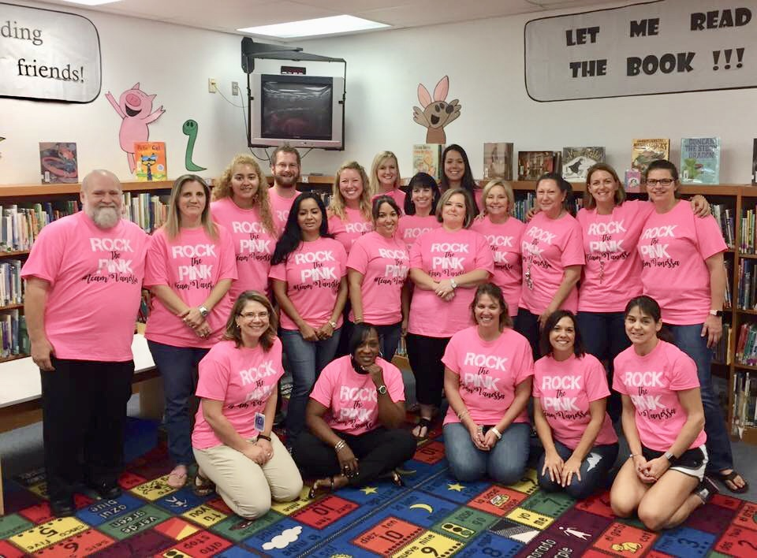
The Fairlawn Family supporting students, families, and our community

Slide 8
Relationships First!
But Data Drives Instruction……

Slide 9
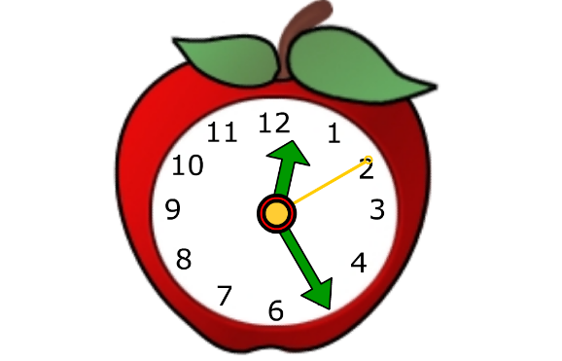
The Master Schedule
!

Slide 10
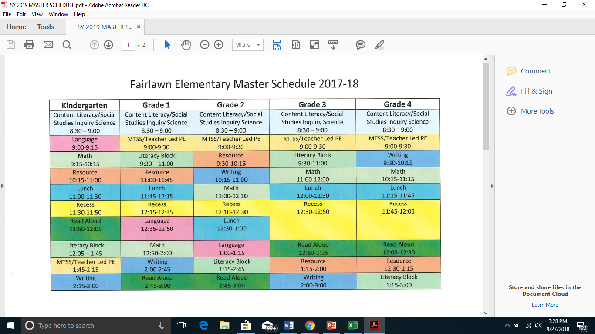
How do we fit it all in?
Notes:
Master Schedule

Slide 11
It’s all in the (COLLABORATIVE) Planning!
Teacher Preparation Time
7:45-8:30 a.m.
Tutoring
Parent Conferences
Students arrival begins at 8:00 a.m.
Morning activities have reduced tardies
Block Scheduled Resource Times
Grade groups collaborate daily
lesson design
assessments
remediation needs
data chats

Slide 12
ALL HANDS ON DECK! To Move Students Forward
All available staff provide support/enrichment during MTSS
Morning Time is enrichment time!***
Mentor/Mentee relationships help everyone grow***

Slide 13
No Kiddos Left Behind –
Student/Staff
Mentorship

Slide 14
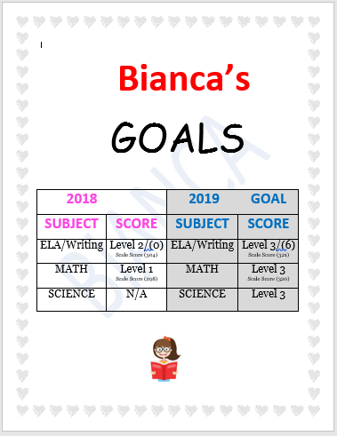
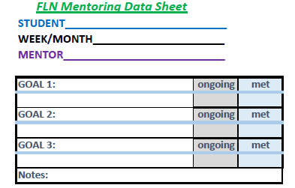
Mentor Monitoring Tools
So We Are
On the
SAME PAGE

Slide 15
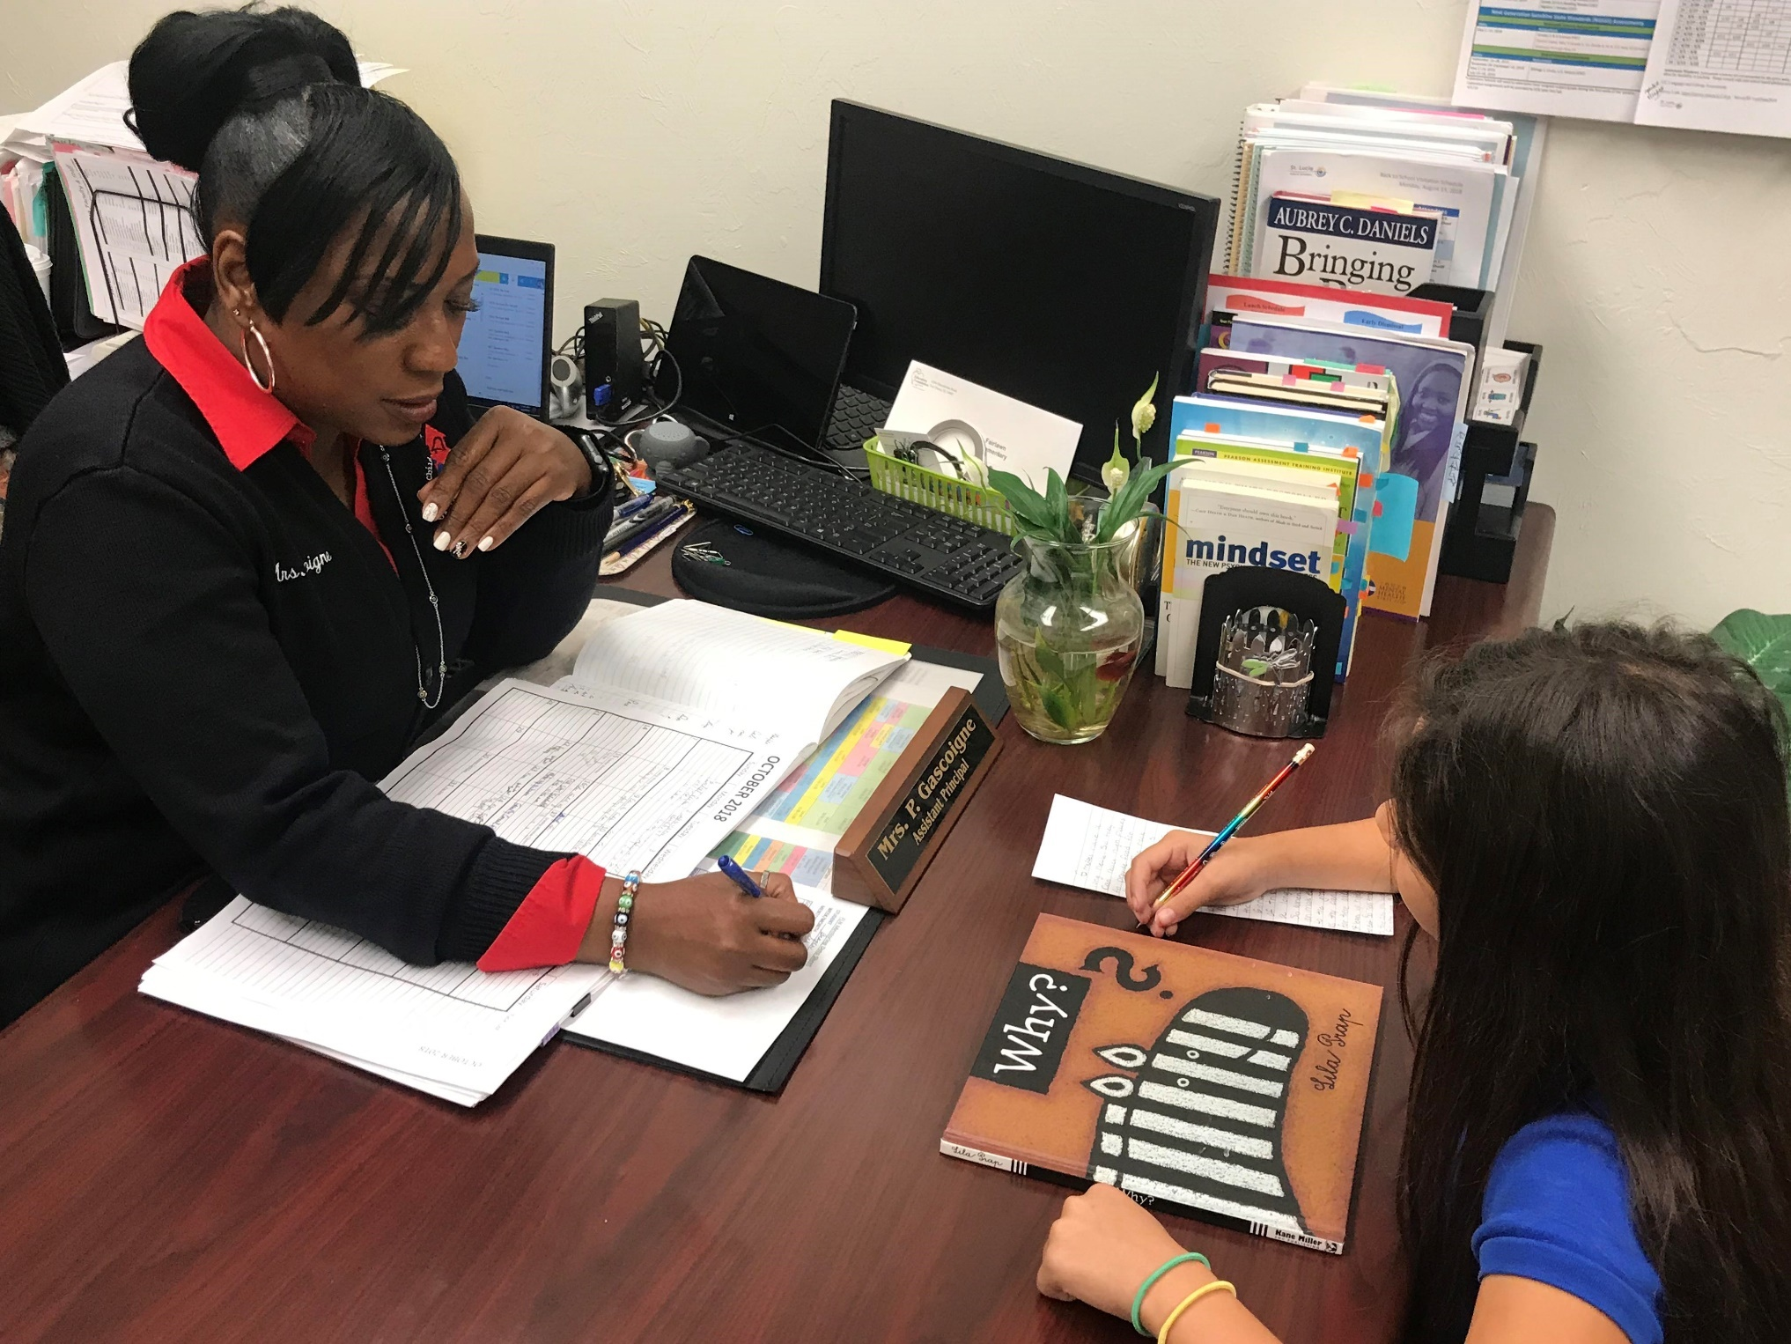
Picture with Bianca

Slide 16
Precision Focus + Small Group Instruction _____________ Learning Gains
Before and After School Tutoring by classroom teachers
FOR COMP TIME!!!
Offered to teachers in grades 3-5
Planning for 2019!
Subs paid for out of Title 1 funds

Slide 17
The More You Read, The Better You Read!
Third Grade Rises to the Morning Reading Challenges!
Students set reading goals
Read from rotating lexiled book bins independently, with a buddy or with a peer mentor
Take Scholastic Reading Counts Quiz
Celebrate Success

Slide 18
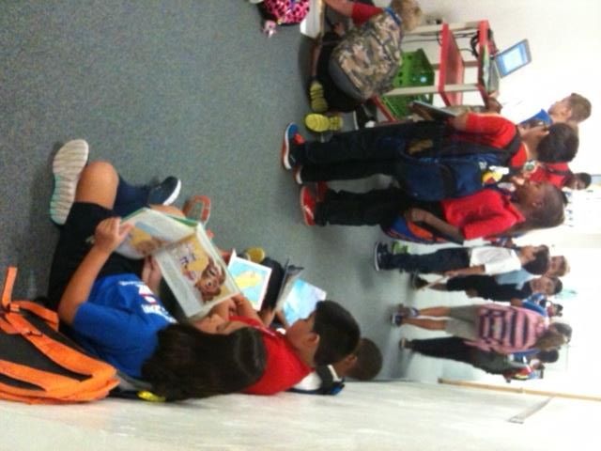
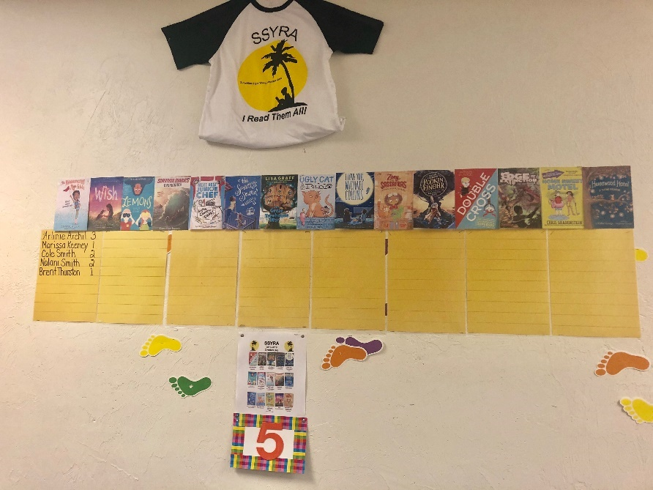
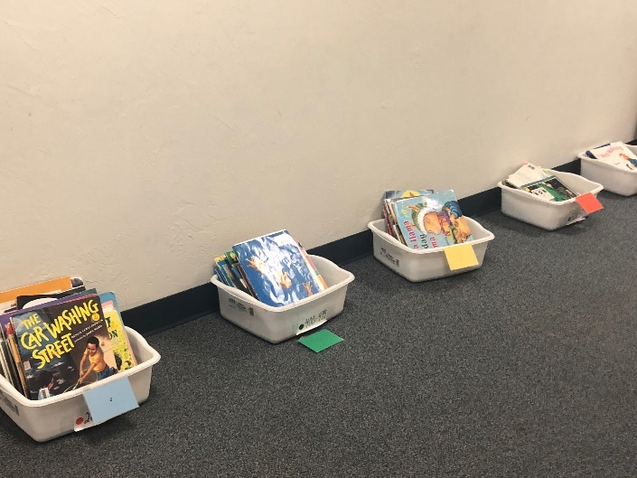
3rd Grade Rocks Reading!
With adult guidance and motivation, students read millions of words during otherwise ‘wasted’ time
Make it Fun!
-Short term goals and challenges
-Instant recognition
-Abundance of appropriate reading selections*

Slide 19
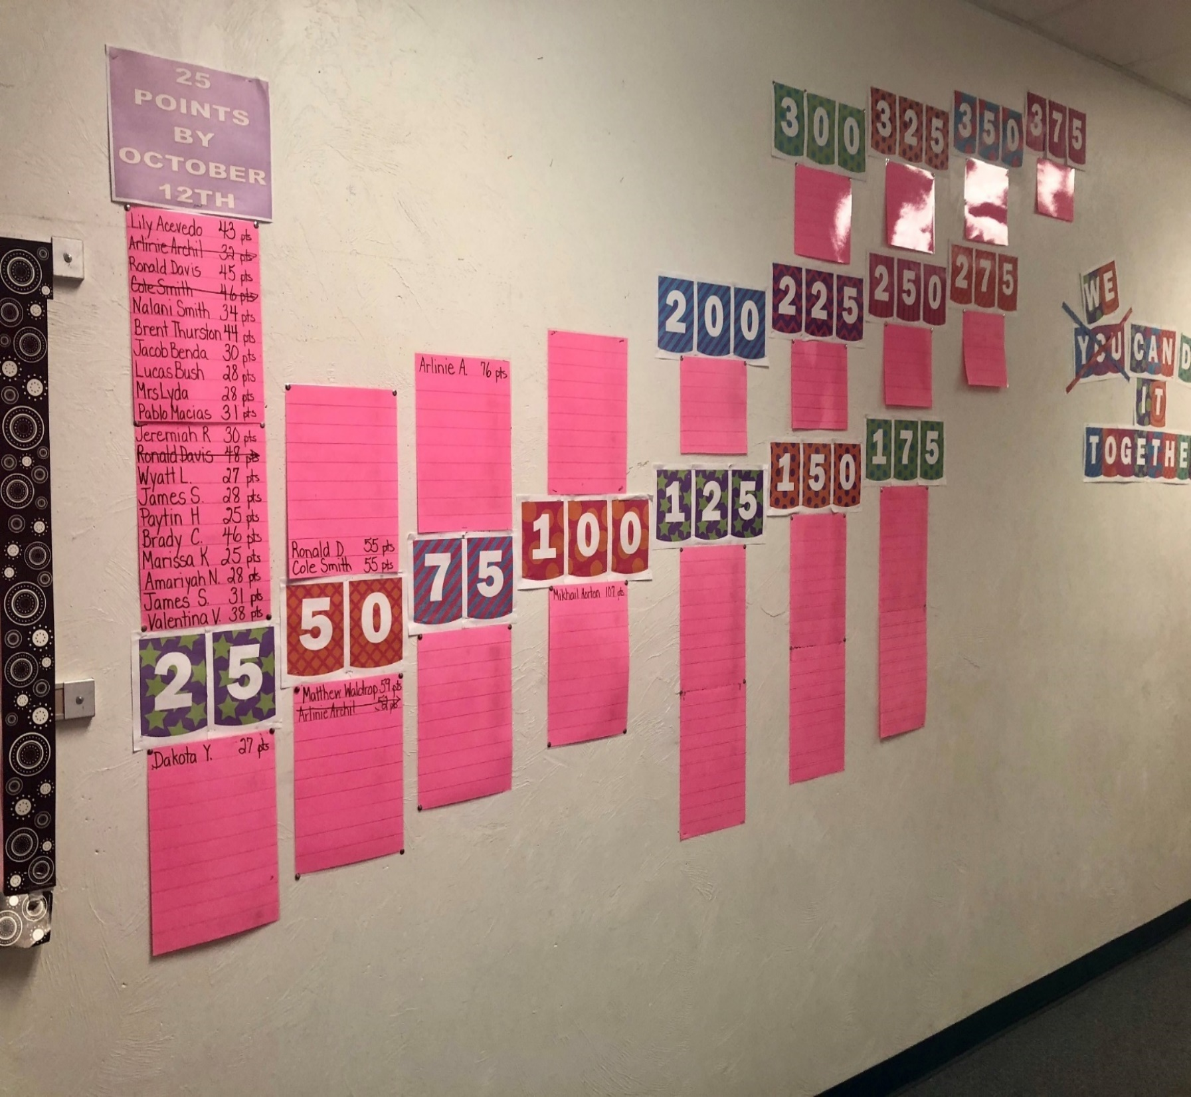

Slide 20
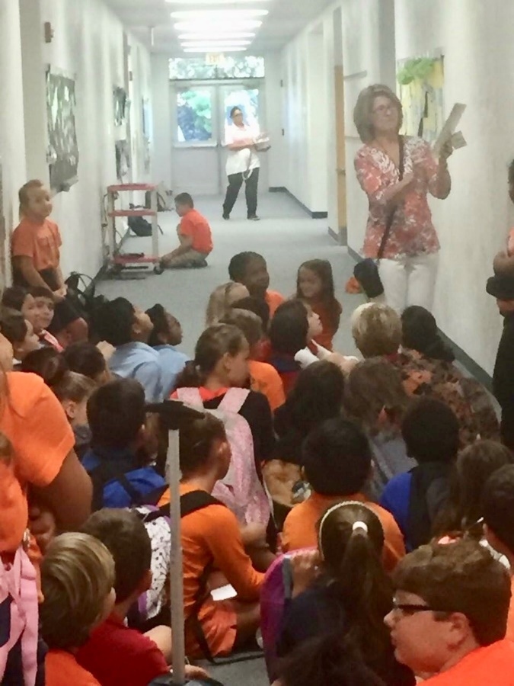
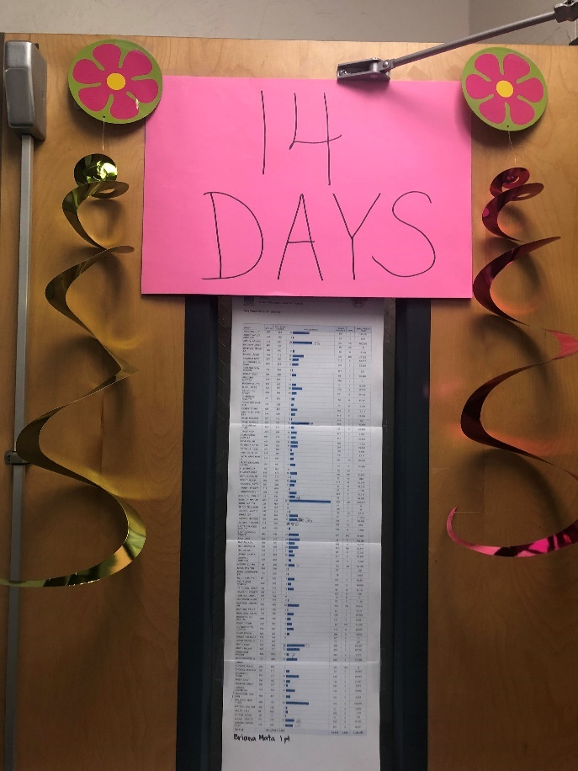
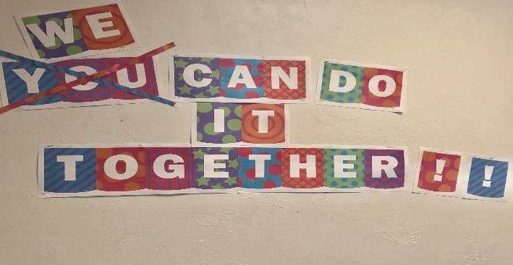
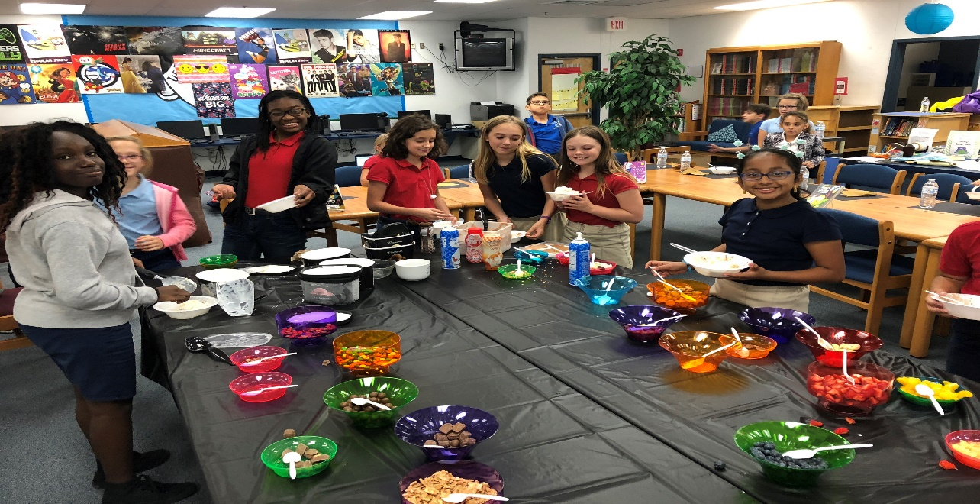
This is how
we
do
it!!!

Slide 21
Building Family Literacy
1 Empower Families
2 Summer Library Hours
3 One School, One Book
If you open it, many will come!
Opening the media center one to two morning a week during the summer brought students and families in to read, relax and have fun!
Share the tools for success!
Your entire school family reads the same book,
at the same time.!
Student
Teachers
Custodians
Office Staff
Bus Drivers
Everyone!
.

Slide 22
Empower Families of Young Readers!
Establish a lending library of early childhood literacy materials to help families bridge the home-to-school gap.
Open the media to make access available and to teach families how to interact with the resources.
Collaborate with classroom teacher.
Supplies that are not checked out will be utilized by 4th and 5th grade students to peer tutor K-2 students in the 30 minute morning hallway time.
Notes:
including phonics readers, literacy games, sight word practice supplies, character plushes with coordinating storybooks, and high quality read aloud selections

Slide 23
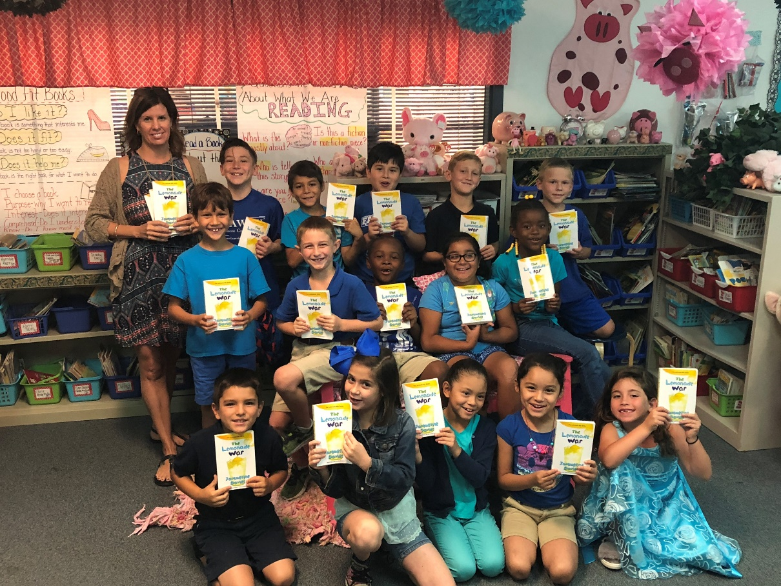
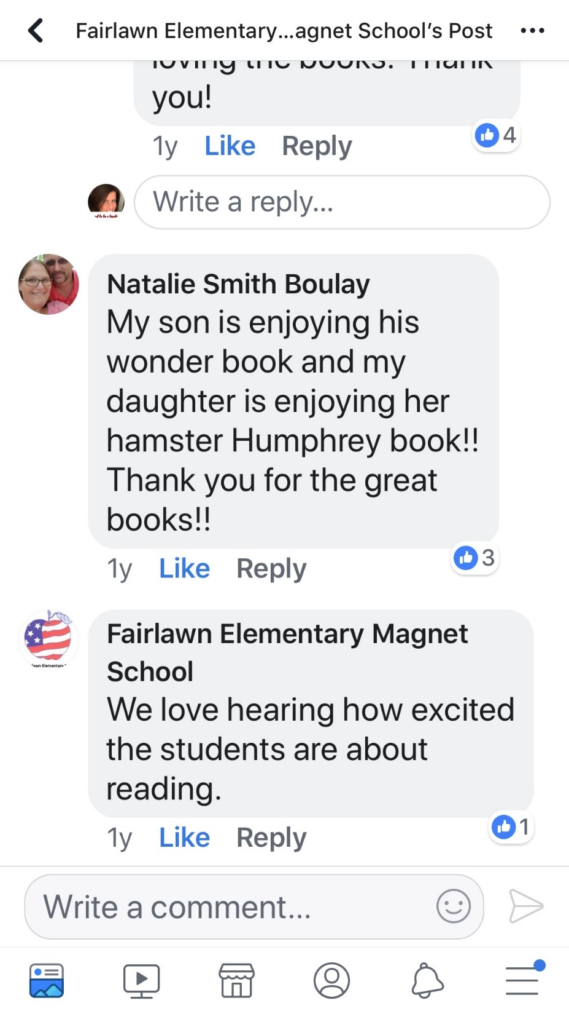
Keep ‘Em Reading TOGETHER
All Summer Long!
Open Library Hours Weekly!

Slide 24
Fairlawn tried it….. and LOVED it!

Slide 26
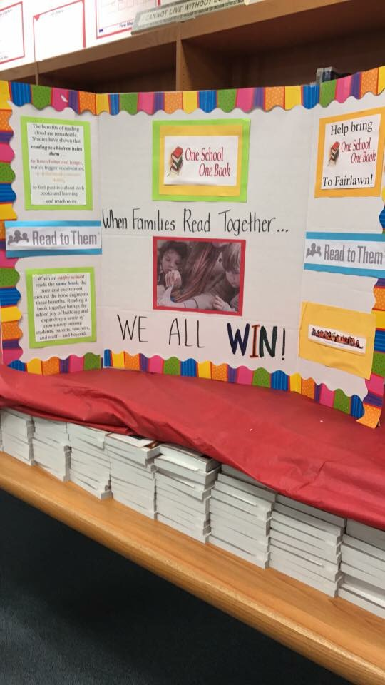
Indian in the Cupboard
Sneek Peeks build interest!

Slide 27
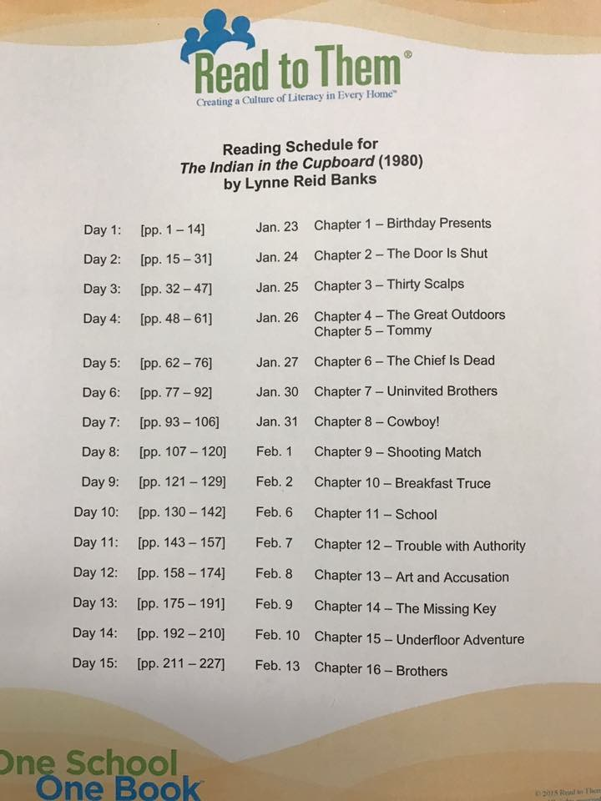
What it looks like!

Slide 28
Celebrate the
Process!
Notes:
What we learned………

Slide 29
Notes:
https://youtu.be/BdveQ1kjlwY

