Slide 1
Department of Education Updates
FASFEPA/ECTAC Fall Forum
September 10, 2019

Slide 2
“Setting the Stage”
Review of major changes in the 2018-19 school year
New Commissioner
Robust Legislative Session
Major Executive Orders 19-31, 19-32
Review of changes in K-12 Public Schools
Chancellor Oliva- reorganization
Bureau of Standards and Instruction and Just Read, Florida! now under Educator Quality with Dr. Burns
Shift of Federal Programs to Melissa Ramsey
Revision to support ALL students at ALL schools- CS&I and TS&I designation
All programs working together
Shape and Collaborate for 2020-21 (Session)

Slide 3
Title Applications Tentative Timeline for 2020-21
Month | Activity
February
March
April
May
June
July
August

Slide 4
Questions to ask
What time? Create comprehensive calendar for the 2020-21 grants
What is the plot? Program specifics including allocation process (Basics 101 session)
Where is my seat? Identify programs to supplement and support one another
What would the critics say? Program monitoring versus an audit
Learning strategies and systems from each other (Monitoring session)

Slide 5
Other Hot Topics
ESSA and Federal Percent of Points Index (Networking Session)
VAM
Transition from Research to Evidence-based Strategies
Return on Investment
Executive Orders
Additional Information

Slide 6
Every Student Succeeds Act - ESSA

Slide 7
ESSA Background
Bipartisan federal law signed in December 2015
Amended the Elementary and Secondary Education Act of 1965, replacing No Child Left Behind provisions
Each state had to submit a state plan detailing how it would comply with the new law
With a strong, proven accountability system, Florida was already ahead of most of the nation as it relates to the requirements of ESSA

Slide 8
Florida's ESSA State Plan
Drafted with public input, including workgroup of superintendents
Approved September 26, 2018
Preserves the focus on increased student achievement
No changes to Florida’s state accountability systems
School Grades
Differentiated Accountability/School Turnaround
Adds a federal calculation to satisfy ESSA requirements
New Federal Percent of Points Index (“Federal Index”)

Slide 9
New ESSA Accountability Provisions
Additional focus on reporting of student subgroup performance
Adjustment for schools that test less than 95%
Inclusion of English Language Learner (ELL) proficiency progress as a separate accountability indicator, as required by US Department of Education

Slide 10
95% Requirement
Schools that test less than 95% will have achievement component modified to include non-tested students in denominator to get up to 95% tested, counted as not proficient
Schools that test at least 95% will see no change in this component between school grade and federal index

Slide 11
ELP Progress Component Calculation
The ELP Progress component is worth 100
Denominator – Students who are in kindergarten through 12th grade and are full-year-enrolled in the school, with a valid current-year score and a valid prior-year score, and who have a valid combination of assessments
Alternate ACCESS to Alternate ACCESS
ACCESS for ELLs (2.0 and Kindergarten) to ACCESS for ELLs (2.0 and Kindergarten)
Numerator – Students in the denominator that meet one of the following:
Increase one or more composite proficiency levels to the next highest whole number
Maintain a composite level of 4 or higher without decreasing a composite level
Alternate ACCESS - move up one composite scoring category or remain at Proficiency Level P1 (“Entering”) or above without decreasing a scoring category

Slide 12
Federal Index
ESSA Indicator | Florida Component
Academic Achievement – including Student Growth | English Language Arts (ELA) Achievement
 | Mathematics Achievement
 | Learning Gains ELA
 | Learning Gains Mathematics
 | Learning Gains Lowest 25% ELA
 | Learning Gains Lowest 25% Mathematics
Graduation Rate | 4-Year Graduation Rate
School Quality or Student Success | Science
 | Social Studies
 | Middle School – Acceleration
 | High School – College and Career Acceleration
Progress in Achieving English Language Proficiency (ELP) | ELP Progress (new indicator for federal purposes)

Slide 13
Federal Index Calculation
Same student eligibility criteria as School Grades
This includes Alternative, ESE Centers, DJJ schools, and K-2 and K-3 feeder schools
Schools can get a Federal Index based on as little as one component
School-level Federal Index
Determines if a school is in Comprehensive Support and Improvement (CS&I)
Subgroup-level Federal Index
Subgroups Included
White, Black/African American, Hispanic, Asian, Native American, Multiracial, Pacific Islander, Students with Disabilities, Economically Disadvantaged, and English Language Learners.
Determines if a school is in Targeted Support and Improvement (TS&I)

Slide 14
Federal Index Possibility of 12 Components
English Language Arts
Achievement (0% to 100%)
Learning Gains (0% to 100%)
Learning Gains of the Low 25% (0% to 100%)
Mathematics
Achievement (0% to 100%)
Learning Gains (0% to 100%)
Learning Gains of the Low 25% (0% to 100%)
Science
Achievement (0% to 100%)
Social Studies
Achievement (0% to 100%)
Middle School Acceleration
Middle School (EOC or industry certification) (0% to 100%)
Graduation Rate
Overall, 4-year Graduation Rate (0% to 100%)
College and Career Acceleration
High School (AP, IB, AICE, dual enrollment or industry certification) (0% to 100%)
English Language Proficiency Progress
Progress of English Language Learners in Achieving English Language Proficiency (0% to 100%)

Slide 15
Examples for Calculating the Federal Index
English Language Arts
Achievement 41%
Learning Gains 60%
Learning Gains of the Low 25% 53%
Mathematics
Achievement 40%
Learning Gains 55%
Learning Gains of the Low 25% 53%
Science
Achievement 36%
Social Studies
Achievement 53%
Middle School Acceleration
Middle School (EOC or industry certification) 64%
Graduation Rate
Overall, 4-year Graduation Rate 74%
College and Career Acceleration
High School (AP, IB, AICE, dual enrollment or industry certification) 38%
ELP Progress
Progress of English Language Learners in Achieving English Language Proficiency 60%
 | Points Earned | Components | Percent of Points | Overall
School Grades | 567 | 11 | 52% | C
Federal Index | 627 | 12 | 52%
Notes:
K-12 or 7-12.

Slide 16
List of Schools Identified Under ESSA for Additional Support
The list is posted at http://www.fldoe.org/academics/essa
The list contains the school’s Federal Index, overall ESSA status (Comprehensive (CS&I) or Targeted (TS&I) support and improvement), and the subgroups identified for support
At www.floridacims.org the Federal Index and School Grade components are identified and the Schoolwide Improvement Plan (SIP) is available

Slide 17
CS&I and TS&I Criteria
If a school meets any of the following criteria they will be identified for Comprehensive Support and Improvement (CS&I)
School Grade of D or F
Graduation Rate of 67% or below
Federal Index of 40% or below
If a school is not identified as CS&I and they have at least one subgroup with a Federal Index of 40% or they are identified for Targeted Support and Improvement (TS&I)

Slide 18
ESSA Requirements and Timeline for School Improvement Plans
SIP required for all CS&I and TS&I schools (non-charters)
CS&I-SIP shall be approved by the district and state
TS&I-SIP approved by the district
Requirement begins in 2019-20 based on 2018-19 performance that will be released in summer 2019
Notes:
(a) School improvement plans.—The district school board shall annually approve and require implementation of a new, amended, or continuation school improvement plan for each school in the district which has a school grade of “D” or “F”; has a significant gap in achievement on statewide, standardized assessments administered pursuant to s. 1008.22 by one or more student subgroups, as defined in the federal Elementary and Secondary Education Act (ESEA), 20 U.S.C. s. 6311(b)(2)(C)(v)(II); has not significantly increased the percentage of students passing statewide, standardized assessments; has not significantly increased the percentage of students demonstrating Learning Gains, as defined in s. 1008.34 and as calculated under s. 1008.34(3)(b), who passed statewide, standardized assessments; or has significantly lower graduation rates for a subgroup when compared to the state’s graduation rate. The improvement plan of a school that meets the requirements of this paragraph shall include strategies for improving these results. The state board shall adopt rules establishing thresholds and for determining compliance with this paragraph.

Slide 19
Schoolwide Improvement Plan Resources
www.floridacims.org
Updated School Leadership Companion Guide
Webinar was held on May 23, PowerPoint posted in CIMS
Regional teams will facilitate district trainings
Working on exemplar SIP for schools with underperforming subgroups of SWD or ELLs

Slide 20
Tiered Support for CS&I and TS&I
State support will be prioritized based on these factors:
Number of underperforming subgroups
Title I status
Years in TS&I
Notes:
What is Support? The department examines student achievement data to identify schools and districts that need additional support to reduce the achievement gaps in defined subgroups and schools. The goal is to provide a Multi-tiered System of Support that consists of three support levels (Tier 1, Tier 2, and Tier 3).

Slide 22
State, District, and School Report Cards
A new interactive report card provides the federally required components for the state, district, and school report cards
Includes the following:
School grade and school grade components, and Federal Index
Components disaggregated by subgroup
State-, District-, School-level
English Language Proficiency Progress
State-, District-, School-level
Whether or not the school was identified for support
https://edudata.fldoe.org/

Slide 23
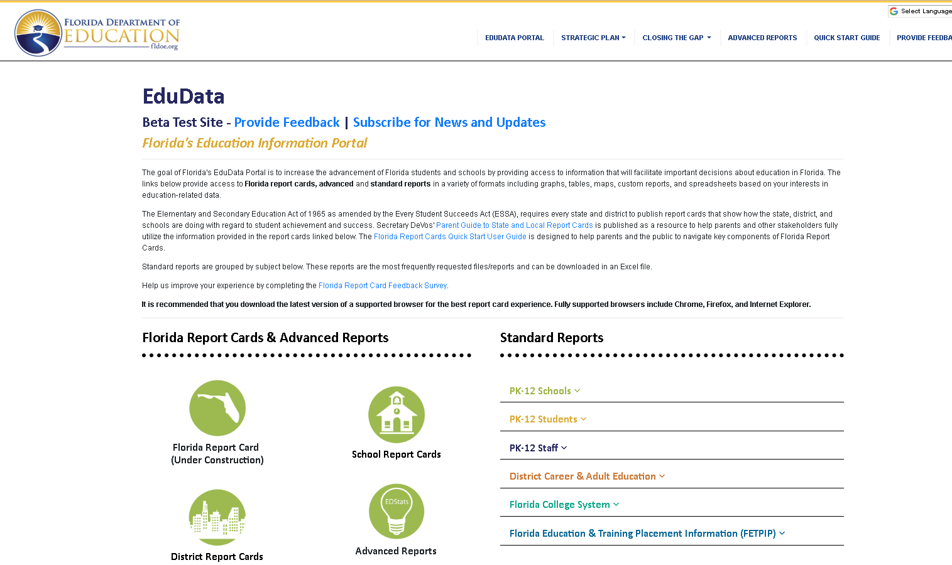
EduData Portal and Report Cards
https://edudata.fldoe.org/index.html

Slide 24
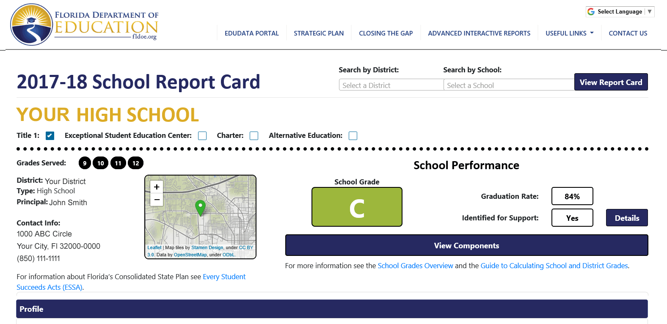
School Report Card

Slide 25
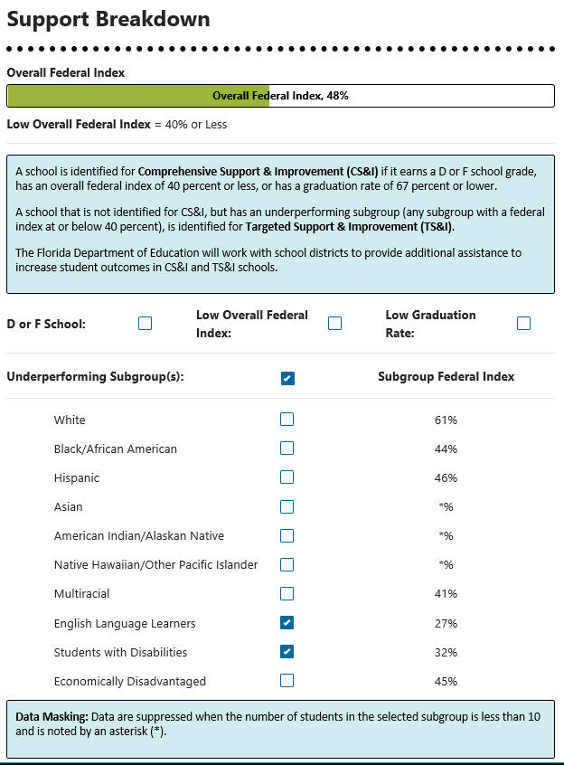
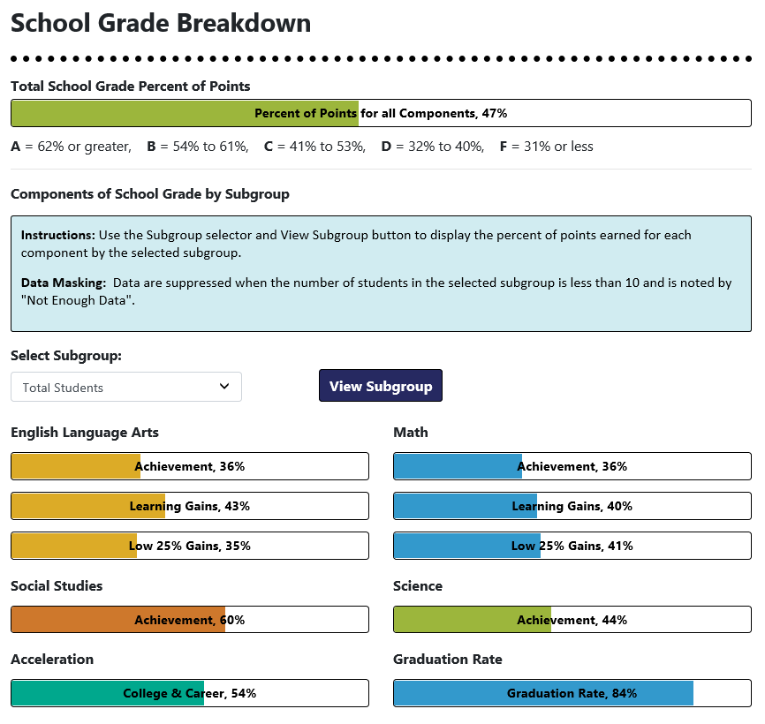
Support and School Grade Breakdowns

Slide 26
Components of School Grade by Subgroup

Slide 27
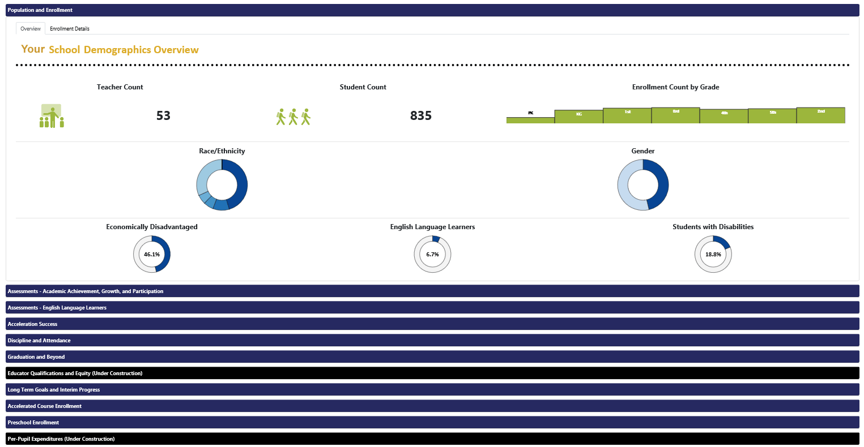
Additional Report Card Sections

Slide 28
English Language Learners – ELA Progress

Slide 29
Statewide View of 2018-19 ESSA Data – CS&I
475 CS&I schools
D or F schools* with Federal Index below 41% 123
C schools* with Federal Index below 41% 3
D schools* with Federal Index above 40% 49
A, B, and C schools* with grad rate of 67% or lower 3
Ungraded schools** with grad rate of 67% or lower 3
Feeder schools with Federal Index below 41% 1
Ungraded schools with Federal Index below 41% 293
* Excludes feeder schools
** With Federal Percent of Points Index of 41% or higher

Slide 30
CS&I Comparison
2017-18 (ESSA baseline) vs. 2018-19
 | 2017-18 552 schools | 2018-19 475 schools | - 77
D or F schools* with Federal Index below 41% | 179 | 123 | -56
C schools* with Federal Index below 41% | 5 | 3 | -2
D schools* with Federal Index above 40% | 51 | 49 | -2
A, B, and C schools* with grad rate of 67% or lower | 13 | 3 | -10
Ungraded schools** with grad rate of 67% or lower | 4 | 3 | -1
Feeder schools with Federal Index below 41% | 4 | 1 | -3
Ungraded schools with Federal Index below 41% | 296 | 293 | -3
* Excludes feeder schools
** With Federal Percent of Points Index of 41% or higher

Slide 31
Summary of the 2018-19 ESSA Data
A total of 1,772 higher-performing schools are identified for Targeted Support & Improvement (TS&I) to address pockets of performance problems with specific student subgroups
This stresses the need to be innovative in even our high-performing schools to address the outcomes of all students, particularly students with special needs
Over half (58%) of the schools identified for TS&I have only one subgroup identified, and the vast majority (96%) have three or fewer subgroups identified

Slide 32
1,772 schools with ESSA identified subgroups
(1) 1031 schools
(2) 473 schools
(3) 203 schools
(4) 46 schools
(5) 17 schools
(6) 2 schools

Slide 33
Of the 1,772 Schools Identified for TS&I - Which Subgroup Missed the Target of 41%
Subgroup | # of Schools | % of Schools
White | 35 | 2%
Black/African American | 534 | 30%
Hispanic | 65 | 4%
Asian | 4 | 0%
Native American | 8 | 0%
Multiracial | 111 | 6%
Pacific Islander | 2 | 0%
Students with Disabilities | 1,621 | 91%
Economically Disadvantaged | 76 | 4%
English Language Learners | 411 | 23%

Slide 34
TS&I Subgroup Comparison
Subgroup | 2017-18 ESSA Baseline |  | 2018-19 ESSA
 | # of Schools | % of Schools | # of Schools | % of Schools
White | 33 | 2% | 35 | 2%
Black/African American | 639 | 33% | 534 (2) | 30%
Hispanic | 87 | 4% | 65 | 4%
Asian | 3 | 0% | 4 | 0%
Native American | 11 | 1% | 8 | 0%
Multiracial | 101 | 5% | 111 | 6%
Pacific Islander | 1 | 0% | 2 | 0%
Students with Disabilities | 1,793 | 92% | 1,621 (1) | 91%
Economically Disadvantaged | 79 | 4% | 76 | 4%
English Language Learners | 517 | 26% | 411 (3) | 23%

Slide 35
Statewide View of 2018-19 ESSA Data – TS&I
944 schools
585 schools

Slide 36
TS&I Statewide View – ESSA Baseline vs. 2018-19
91%
89%
71%
65%
25%
19%
25%

Slide 37
Support for School Improvement
Notes:
A school is identified for Comprehensive Support & Improvement (CS&I) if it earns a D or F school grade, has an overall Federal Index of 40 percent or less, or has a graduation rate of 67 percent or lower.
A school that is not identified for CS&I, but has an underperforming subgroup (any subgroup with a Federal Index at or below 40 percent), is identified for Targeted Support & Improvement (TS&I).
The Florida Department of Education will provide support to school districts to reduce the achievement gap by increasing student achievement in CS&I and TS&I schools.

Slide 38
School Improvement Categories
Will be identified on new report cards
Federal Comprehensive Support and Improvement (CS&I) for DA Schools/Current State CS&I and TS&I
NEW Federal Comprehensive Support and Improvement (CS&I) Based on 2017-18 performance
NEW Federal Targeted Support and Improvement (TS&I) Based on 2017-18 performance
Current grade “D” | Differentiated Accountability (DA) Support
Current grade “F” | DA Support
Not “D” or “F” but graduation rate 67% or lower | DA Support
Not “D” or “F” but overall Federal Index of 40% or lower | Tiered Support
A TS&I school with a subgroup Federal Index of 40% or lower for 6 years* | Tiered Support
Any subgroup performance on Federal Index of 40% or lower in the current year *moves to CS&I after 6 years | Tiered Support
Any subgroup performance on Federal Index of 31% or lower for 3 consecutive years | Tiered Support

Slide 39
Tiers of Support to
SI Schools
3 options for
Turnaround
External Operators
School Improvement Plan
Regional Team works with district and school leadership teams
Instructional Reviews
First time D’s, Grad Only
District-managed Turnaround
Submit Quarterly Data
District-managed turnaround
Tier 3
Tier 2
Tier 1
* Tiering requirements escalate
Federal CS&I (D, F, Grad Only)
Notes:
This slide shows the tiers of support provided to DA schools based on their 2018 school grade.
DA support is intended to build capacity by focusing on systems and structures needed to accelerate and sustain school improvement. Support is provided by our regional school improvement teams in consultation with the district to determine local needs. This support typically includes facilitation of collaborative processes such as data and risk analyses, needs assessment, strategic planning and problem solving, performance management, professional development, and cross-district networking to share promising practices and lessons learned.
The regional teams review, provide feedback, and monitor progress on the implementation of school improvement plans and turnaround option plans.
Tier 1 – There are currently 115 schools that receive tier 1 support. This number consists of 106 first time D’s, 8 grad-only schools, and 1 school with an Incomplete.
Tier 1 consists of the following interventions:
Completion of a School Improvement Plan which details school-based interventions.
Monthly visits by our regional teams to monitor schools and districts.
Instructional Reviews are conducted multiple times throughout the year.
Memorandum of Understanding (MOU) as previously discussed.
In addition, DA schools qualify for Title I, Part A School Improvement funds to support strategies identified in the School Improvement Plan.
Tier 2 – There are currently 74 district-managed turnaround schools that receive tier 2 support. These schools receive tier 1 support as well as the following additional interventions for tier 2:
Completion of a Turnaround Option Plan; typically, district-managed turnaround is selected as the first option.
Verification of instructional personnel's state VAM.
Quarterly submission of teacher and student data to the Department.
Bi-weekly visits by our regional teams to monitor schools and districts.
Tier 3 –There are currently 14 schools that receive tier 3 support. These schools still receive tier 1 and tier 2 support, as well as the following additional interventions for tier 3:
Completion of a Turnaround Option Plan for the next cycle of turnaround implementation.
Weekly contacts by our regional teams to monitor schools and districts.
Visit by the Chancellor or Executive Director of School Improvement.

Slide 40
Tiered Support for Schools Not in SI

Slide 41
Tiered Support for Schools not in SI
Identification Based on Federal Index
CS&I
Tier 3
Intensive
Supports
TS&I
Tier 1
Universal Supports
TS&I
Tier 2
Supplemental Supports
3 Schools
Annual OVERALL school Federal Index (40% or lower) 2019-20
6 years of same low subgroup (40% or lower) 2023-24
3 years of same low subgroup (31% or lower) 2020-21
1,772 Schools
Annual low subgroup Federal Index (40% or lower) 2019-20

Slide 42
Universal Supports (Tier 1, TS&I)
General, statewide support designed to inform, assist and improve student achievement, including:
Technical assistance and conference calls
Professional Development
Size-alike or issue-alike problem-solving groups
Best Practices for Inclusive Education (BPIE)
District ELL plan
K-12 Reading Plan
NEW in 2019-20: Districts will approve School Improvement Plans (SIPs) identifying the sub-group(s) and outline specific goals and interventions.
Notes:
Tier 1 is universal support available to all stakeholders across the state. Support is primarily online and includes resources for teachers, administrators, parents, and the general public. Starting in 2019-20, schools shall annually complete a School Improvement Plan identifying the sub-group(s) and outline specific goals and interventions. Districts shall approve the plan(s).

Slide 43
Supplemental Supports (Tier 2, TS&I)
More focused and frequent support in addition to and aligned with universal supports that are specialized to identified subgroup(s) including:
Grade-level and content-level specific
Assistance from FDOE staff and partners
NEW in 2020-21: Schools will only qualify for Tier 2 after three years of the same subgroup’s underperformance in Tier 1. Districts will approve a SIP identifying the specific sub-group(s) and outline specific goals and interventions.
Notes:
Tier 2 is supplemental support provided to specific districts and schools based on identified subgroups. Support is grade-level and content-specific to increase student achievement and decrease the achievement gap. The support is more focused, frequent, and requires specialization in the identified subgroup(s). Starting in 2020-21, schools shall annually complete a School Improvement Plan identifying the specific sub-group(s) and outline specific goals and interventions. Districts shall approve the plan(s).
*Schools will only qualify for Tier 2 after three years of the same subgroup’s underperformance in Tier 1. The earliest this will begin is the 2020-21 school year.

Slide 44
Intensive Supports (Tier 3, CS&I)
Most focused, and frequent support in addition to and aligned with universal and supplemental supports, including:
Monitoring of progress of SIPs to ensure use of resources and best (evidence-based) practices
Review prioritization of support and disbursement of federal funds at the district level
NEW in 2019-20: Districts and the Department will approve School Improvement Plans (SIPs) identifying the sub-group(s) and or school achievement gap and outline specific goals and interventions.
Notes:
Tier 3 is intensive support provided exclusively to specific districts and schools based on identified subgroups or overall low performance. Direct support is provided to leaders and teachers by the Department with continuous monitoring on progress to increase the likelihood of implementation and sustainability. Starting in 2019-20, schools shall annually complete a School Improvement Plan identifying the specific sub-group(s) or school achievement gap and outline specific goals and interventions. Districts and the Department shall approve the plan(s).

Slide 45
Understanding VAM

Slide 46
VAM Models
Currently, VAM models are generated annually for the following subjects and grades:
English language arts
4th, 5th, 6th, 7th, 8th, 9th, 10th
Mathematics
4th, 5th, 6th, 7th, 8th
Algebra 1
8th & 9th

Slide 47
Covariates
ELA/Mathematics
Up to 2 prior test scores
Number of subject relevant courses
Disabilities
English language learner status
Gifted status
Attendance
Mobility
Difference from modal age of peers in the same grade
Class size
Similarity of prior test scores among students in the class

Slide 48
Value-Added Results and Scores
The formula produces a value-added score for a teacher, which reflects the average amount of learning growth of the teacher’s students above or below the expected learning growth of similar students in the state, using the variables accounted for in the model.
A score of “0” indicates that, on average, students performed no better or worse than expected based on the factors in the model.
A positive score indicates that students, on average, performed better than expected.
A negative score indicates that students, on average, performed worse than expected.

Slide 49
Value-Added Performance-Level Standards

Slide 50
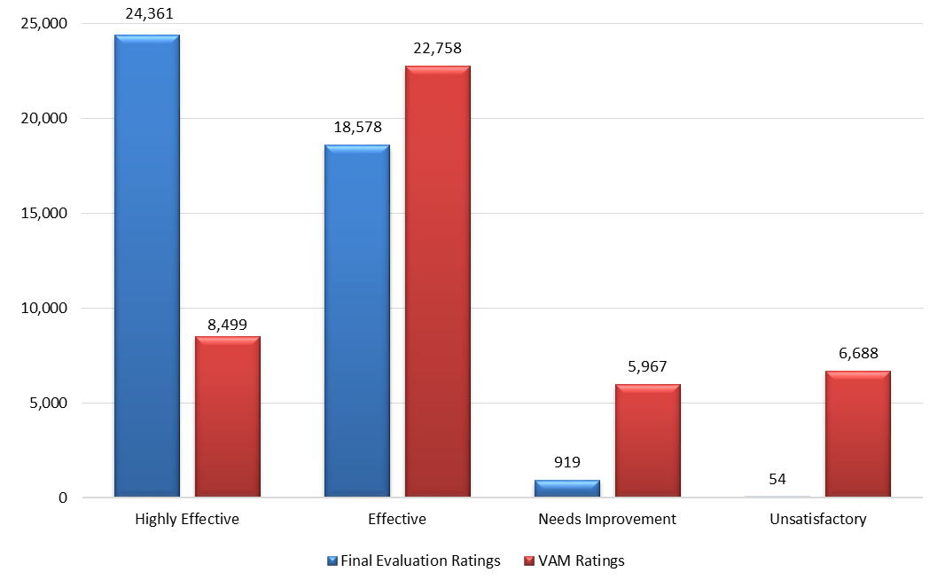
2017-18 District Final Evaluation Rating Compared to VAM Score Classification

Slide 51
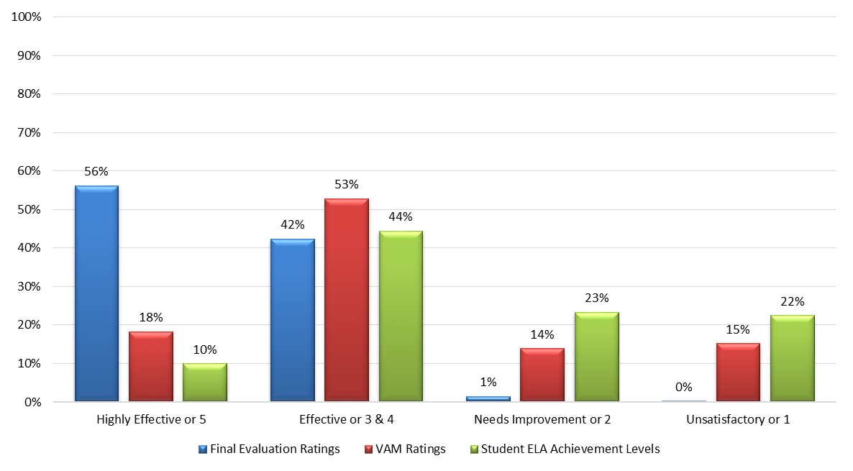
2017-18 Teacher Ratings Compared to Student Achievement

Slide 52
VAM Review, Results, and Process

Slide 53
VAM Review
Data Visualization Tool procurement
Provides transparency into VAM scores
Aids teachers and administrators an easy way to
Understand what a VAM score is
How to best use a VAM score
Question to ask:
Does your district do “data chats” with teachers?

Slide 54
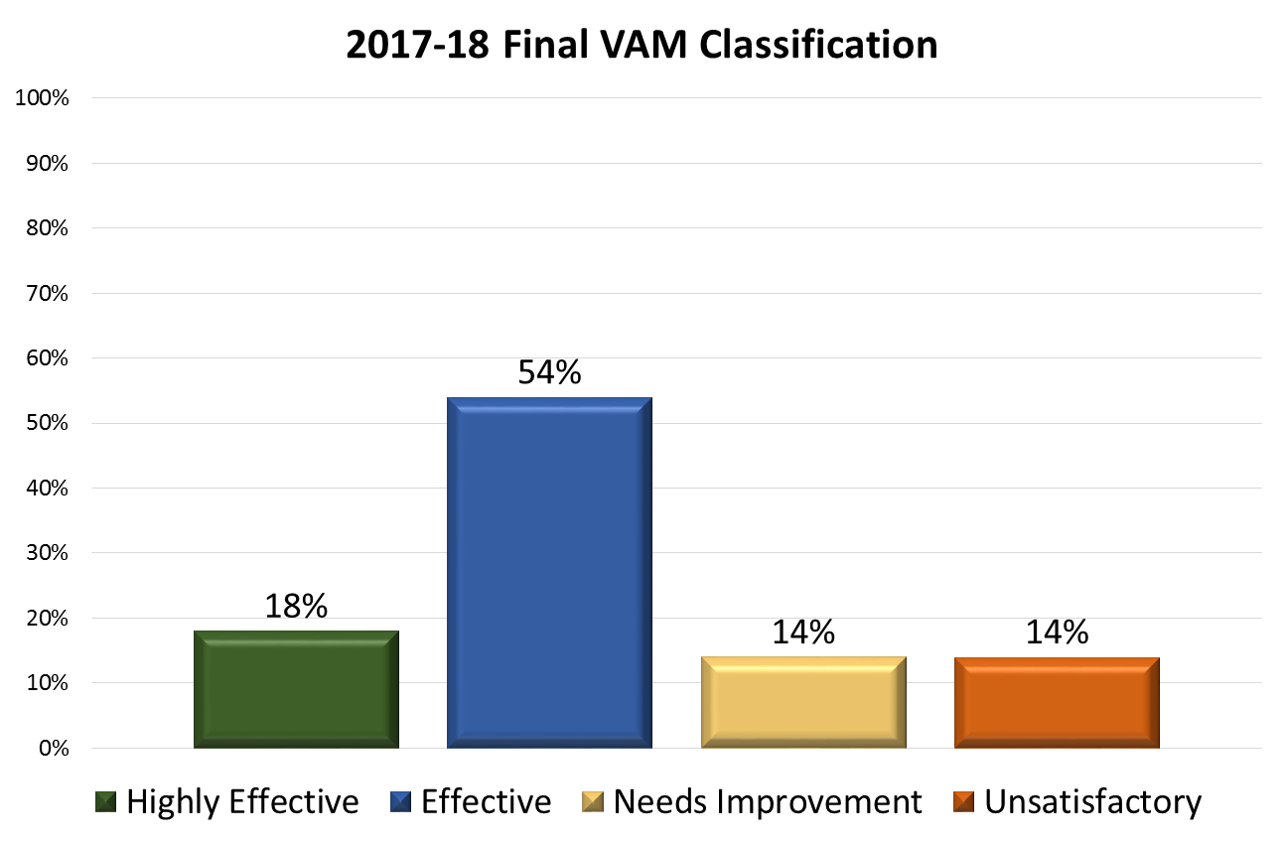

Slide 55
2018-19
17%

Slide 56
VAM Review
Statutory references
Section 1004.04(4)(a)3.c., F.S.: Continued approval for teacher preparation programs
Section 1012.56(7)(c), F.S.: One-year extension of a temporary certificate based on Effective or Highly Effective VAM rating
Section 1012.731(3)(a)2., F.S.: Beginning in 2020-21, allows a classroom teacher to qualify for the highest award tier (Best and Brightest) without an overall evaluation of Highly Effective if the teacher has a VAM score that is classified as Highly Effective
High Impact Teacher designation

Slide 57
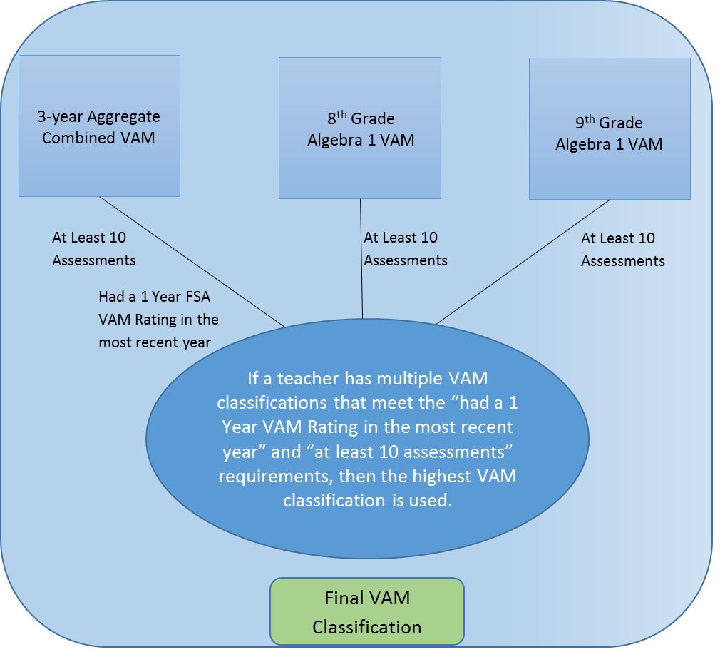
Final VAM Classification

Slide 58
VAM Review for School Improvement
6A-1.099811, Differentiated Accountability State System of School Improvement
Approved by the State Board in July 2018
Requires the teacher’s state VAM score to be reviewed when determining teaching assignments at low-performing turnaround schools
Requirement for district-managed turnaround schools
At or below the district average (if 5 schools in district)
If below 5 schools in the district, use state average
Requirement for Cycle 2-3 turnaround school
No Unsatisfactory or Needs Improvement teachers allowed

Slide 59
2019-20 NEW UniSIG Teacher Supplemental Allocation
Allocates $15,000 to Highly Effective and $7,500 to Effective state VAM teachers teaching by August 30, 2019, at an eligible “D” of “F” school.
Uses 3-year aggregate for ELA and Math, except for Algebra 1 uses 1-year score
2016-17
4th grade ELA and Math=
Effective
2017-18
4th grade ELA and Math= Highly Effective
2018-19
3rd grade ELA and Math=
?

Slide 60
Final VAM Classification

Slide 61
Research versus Evidence-based Interventions/Strategies

Slide 62
ESSA Requires Evidence-based Interventions/Strategies
Evidence-based interventions are practices or programs that have evidence to show that they are effective at producing results and improving outcomes when implemented. The kind of evidence described in ESSA has generally been produced through formal studies and research. Under ESSA, there are four tiers, or levels, of evidence:
Tier 1 – Strong Evidence: supported by one or more well-designed and well-implemented randomized control experimental studies.
Tier 2 – Moderate Evidence: supported by one or more well-designed and well-implemented quasi-experimental studies.
Tier 3 – Promising Evidence: supported by one or more well-designed and well-implemented correlational studies (with statistical controls for selection bias).
Tier 4 – Demonstrates a Rationale: practices that have a well-defined logic model or theory of action, are supported by research, and have some effort underway by an SEA, LEA, or outside research organization to determine their effectiveness.

Slide 63
Strengthen ESEA Investments
Notes:
Identifying local needs: States and districts should do extensive outreach to communities, including pouring over data and talking to parents, teachers, and students to get a sense of where a school's problems may stem from. They should consider whether the school, or a particular population within the school, is getting access to a fair share of resources (including good teachers).
Selecting evidence: States and districts should go with the highest level of evidence possible (i.e. "strong") and consider whether there is evidence that a strategy has worked in the context they want it to. For instance, if a district is trying to help a school do a better job educating rural English-language learners, the best intervention should be one that's been shown to work with that population.
Plan for implementation: That means coming up with clear goals and timelines and figuring out what resources a school needs to get its turnaround off the ground.
Examine and reflect: Schools, districts, and states should think carefully about why the intervention has worked—or hasn't—and what needs to be tweaked. And they should make sure that the school shares what worked and what didn't with others.
A second part of the guidance offers states and districts suggestions for setting a high bar when it comes to defining the different "tiers" of evidence (promising, moderate, and strong).
If a significant number of states and districts decide to take the department's proposed definitions to heart, it could have serious implications for the research community. As of right now, there aren't a ton of interventions that meet the highest standard laid out in this guidance. And there would need to much more high-quality research on how particular interventions impact different populations.

Slide 64
Questions to ask:
How do we evaluate and select evidence-based interventions/strategies?
How do we determine our district capacity to implement with fidelity?

Slide 65
Evaluating and Selecting Evidence
What do the majority of studies on this intervention find? Does the intervention have positive and statistically significant effects on important student (or other relevant) outcomes across many studies? Do any studies have null, negative, or not statistically significant findings? If you are conducting your own literature review about a particular intervention, it is essential to pay attention to the complete picture of what the research reveals rather than relying on just a small number of studies.
How rigorous are the study designs in terms of the strength of the claim that the intervention caused the outcome obtained, rather than just being correlated with it? Do any meet the criteria for strong or moderate evidence, as defined in ESSA?¹ As a point of reference, only randomized control trials and quasi-experimental methods can demonstrate causality.
Was the intervention implemented in contexts similar to your own (e.g., similar enrollment size, geography (rural or urban), governance structures, relevant legal or regulatory requirements)?
Was the intervention implemented among students similar to those you aim to serve (e.g., English language learners, students more than one year behind in mathematics)?

Slide 66
Determining Capacity
What resources are required to implement this intervention?
Will the potential impact of this intervention justify the costs, or would more cost-effective interventions accomplish the same outcomes?
What is the local capacity to implement this intervention? Are funds available? Does staff have the needed skills? Is there buy-in for the intervention?
How does this intervention fit into larger strategic goals and other existing efforts?
How will this intervention be sustained over time?

Slide 67
Return on Investment

Slide 68
Determine if it is Working
About building and sharing evidence:
How will we know if we are successful?
What are interim progress and performance milestones that can be tracked?
What have participants (i.e., students and educators) in the intervention shared about their experience and how the intervention was implemented?
Should we evaluate the effectiveness of the intervention through a study that could produce strong evidence or moderate evidence, as defined by ESSA? Or would promising evidence from a correlational study or performance data that demonstrates a rationale suffice? What is the strength of the evidence required to monitor whether, how, and why your intervention was successful or not in your context?
How could evidence about this intervention be shared with others and incorporated into decision-making going forward?
Based on evidence, should this intervention continue as is, be modified, or be discontinued?

Slide 69
Examples of Resources
Professional Associations/Conferences
Other Education Publications
Online Research
University Affiliations
State Resources
Colleagues
Federal Resources
Other Education Networks
Peer Reviewed Journals

Slide 70
How do districts collaborate?
Charter Networks
Professional Roundtables
Content Roundtables
Regional Collaboratives
Conferences

Slide 71
Resources- Evidence and Research Clearinghouses
Best Evidence Encyclopedia Produced by the Center for Data-Driven Reform in Education at Johns Hopkins University School of Education. Covers reading, mathematics, science, comprehensive school reform, and early childhood interventions.
Blueprints for Violence Prevention A national violence prevention initiative to identify programs that are effective in reducing adolescent violent crime, bullying, delinquency, and substance abuse.
ERIC (Education Resources Information Center) A federal site providing access to many educational resources, including research.
Evidence for ESSA Produced by the Center for Research and Reform in Education (CRRE) at Johns Hopkins University School of Education. Focused on K-12 reading and mathematics interventions.
IES REL Network A search engine for resources produced by the federal Institute for Education Sciences' Regional Education Laboratories.
National Technical Assistance Center on Transition NTACT is a Technical Assistance and Dissemination project, funded by the U.S. Department of Education's Office of Special Education Programs (OSEP) and the Rehabilitation Services Administration (RSA). NTACT is charged with assisting stakeholders in implementing evidence-based and promising practices and predictors that promote positive post-school outcomes for all students with disabilities. Throughout the website and other resources from NTACT, effective practices and predictors have been evaluated regarding the amount, type, and quality of the research conducted.
Results First Clearinghouse Database Produced by The Pew Charitable Trusts and the John D. and Catherine T. MacArthur Foundation; covers education, child welfare, juvenile and criminal justice, health, and other social programs.
Social Programs That Work Developed by the Coalition for Evidence-Based Policy this site offers a series of papers on social programs that are backed by rigorous evidence of effectiveness.
The What Works Clearinghouse (WWC) Produced by the U.S. Department of Education's Institute of Education Sciences (IES). Covers a wide range of education interventions and practices from pre-K through postsecondary.
Notes:
This section includes a list of some of the clearinghouses currently available for educators' use in researching effective, evidence-based practices. These clearing houses provide summaries of individual studies.

Slide 72
Executive Order 19-31

Slide 73
Charting a Course for Florida to be #1 in the nation in Workforce Education by 2030
Notes:
.

Slide 74
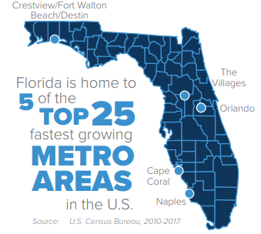
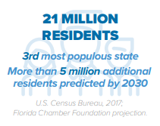
Florida’s population is growing
Source: Florida Chamber of Commerce’s “Florida 2030” https://www.flchamber.com/florida-2030/

Slide 75
Florida’s job market is growing, but…
Source: Florida Chamber of Commerce’s “Florida 2030” https://www.flchamber.com/florida-2030/

Slide 76
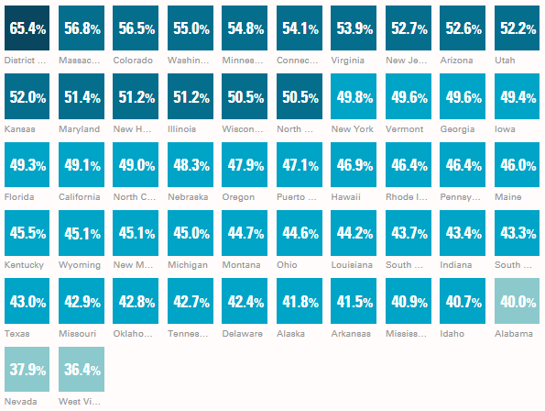
Florida Ranks #20 Among States in Educational Attainment Beyond High School – 2019
Source: Lumina Foundation's "A Stronger Nation“ http://strongernation.luminafoundation.org/report/2019/#nation

Slide 77
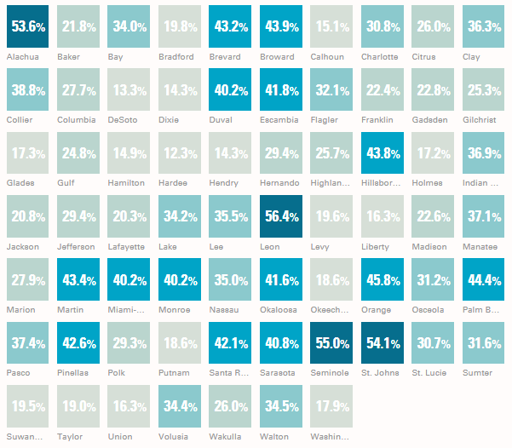
Degree Attainment by County (at least AA) – 2019
Source: Lumina Foundation's "A Stronger Nation“ http://strongernation.luminafoundation.org/report/2019/#nation

Slide 78
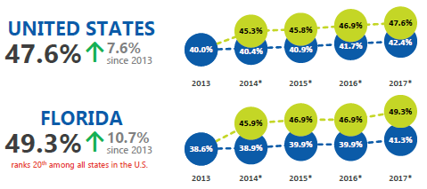
Attainment Progress – 2019
Residents with a high-quality degree or credential
2-year degree or higher
Includes workforce-relevant certificates
*An estimated 8% of Florida residents and 5.2% of U.S. residents hold a workforce-relevant certificate, according to Lumina Foundation. These data are not yet available at
the county level.
Source: U.S. Census Bureau, American Community Survey 1-year estimate and Lumina Foundation Stronger Nation Report

Slide 79
Florida’s Career and Technical Education (CTE) Career Clusters

Slide 80
Workforce Education System – Pathway to a Career

Slide 81
Executive Order 19-32
Notes:
EO 19-32 is the one you’re probably most interested in, as it deals directly with K-12 standards.

Slide 82
Executive Order 19-32 DOE Tasks
Make recommendations to the Governor by January 1, 2020, to:
Eliminate Common Core from Florida’s standards
Provide a roadmap to make Florida’s standards #1
Create opportunities for public input
Improve the quality of instructional curriculum
Suggest innovative ways to streamline testing
Focus on civics literacy
Outline a pathway to become the most literate state
Notes:
The specific tasks of this EO are shown here. Recommendations on these items will be made to the Governor by January 1, 2020. This is a very tight timeline.

Slide 83
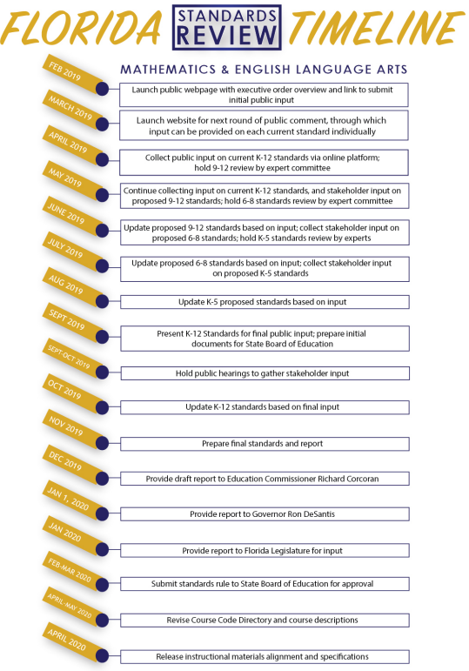

Slide 84
September 2019
Proposed second draft of Florida’s standards will be available for public input in EdCredible
October 2019
Hold roundtable meetings across the state (in very large to small districts) to gather stakeholder input
Update K-12 standards based on final input
November 2019
FDOE to prepare final standards and report
December 2019
FDOE draft report to Commissioner
January 2020
FDOE report to Governor for approval
February – March 2020
Florida State Board of Education approves

Slide 85
Florida Department of Education
State Standard Public Review Data Analysis
Updated 9-3-2019

Slide 86
By the numbers…
# of grade level/strand review forms started – 3,481
# of grade level/strand review forms submitted– 2,353
# of registered users that started a review – 2,036
# of users that submitted a review – 1,153
# of FL school districts/entities (Charters, Diocese, etc.) represented - 81
# of standards reviewed by public
79,075 Submitted
74,268 User
4,807 System
# of pending reviews – 18,921
# of math reviews submitted – 28,647
# of ELA reviews submitted – 50,428

Slide 95
Takeaways
Standards review will be conducted during 2019, with recommendations due to Governor DeSantis January 1, 2020
No changes to statewide assessments or school grades calculation in 2018-2019 and 2019-2020 related to the executive order
Extensive public input opportunities will be available, before the recommendations are submitted and again through State Board of Education rulemaking process
Instructional materials adoption timeline has been revised
Additional details and updates will be provided throughout the review process; visit www.fldoe.org/standardsreview
Notes:
This slide was from our webinar a few months ago that you have probably seen.

Slide 96
Additional Information
Current Status of EGMA

