Slide 1
School Improvement Updates School Improvement Plan and Other Updates
Notes:
The Every Student Succeeds Act (also known as ESSA) is a bipartisan federal law that was signed in December 2015.
It amended the Elementary and Secondary Education Act of 1965, replacing No Child Left Behind provisions.
Each state had to submit a state plan detailing how it would comply with the new law.
With a strong, proven accountability system, Florida was already ahead of most of the nation as it relates to the requirements of ESSA.

Slide 2
Mission
The Bureau of School Improvement (BSI) serves as a partner in supporting improved outcomes for all students through strategic problem solving, capacity building, and the implementation of sustainable systems in the areas of:
Transformational Leadership
Standards-based Planning, Instruction, and Learning
Positive Culture and Environment

Slide 3
Vision
We serve districts and schools as collaborative partners to support continuous improvement and improved outcomes for all students by:
Providing monitoring and support to low performing schools
Building positive relationships, effective communication, and a growth mindset among all stakeholders
Supporting an equitable learning environment focused on improving student outcomes and closing the achievement gap
Coaching for standards-aligned learning and evidence-based interventions
Utilizing various data for purposeful planning and problem solving

Slide 4
DA Highlights
% of DA schools graded “D” or “F” in 2017 improved their grade in 2018
% of DA schools graded “F” in 2017 improved their grade in 2018
% of 2017-18 first year turnaround schools improved their 2018 school grade to a C or better and exited turnaround
Schools in DA
2013-14 | 420
2014-15 | 467
2015-16 | 498
2016-17 | 467
2017-18 | 223
2018-19 | 203
68
94
59
*These numbers are based on schools that received grades in both 2017 and 2018.
Notes:
Turnaround schools:
92 schools entered turnaround for the 2017-18 school year
59 schools are no longer in turnaround, of those 59, 48 exited (47 C or higher, 1 school has an Incomplete), 8 closed, 3 chose an School Improvement Rating.

Slide 5
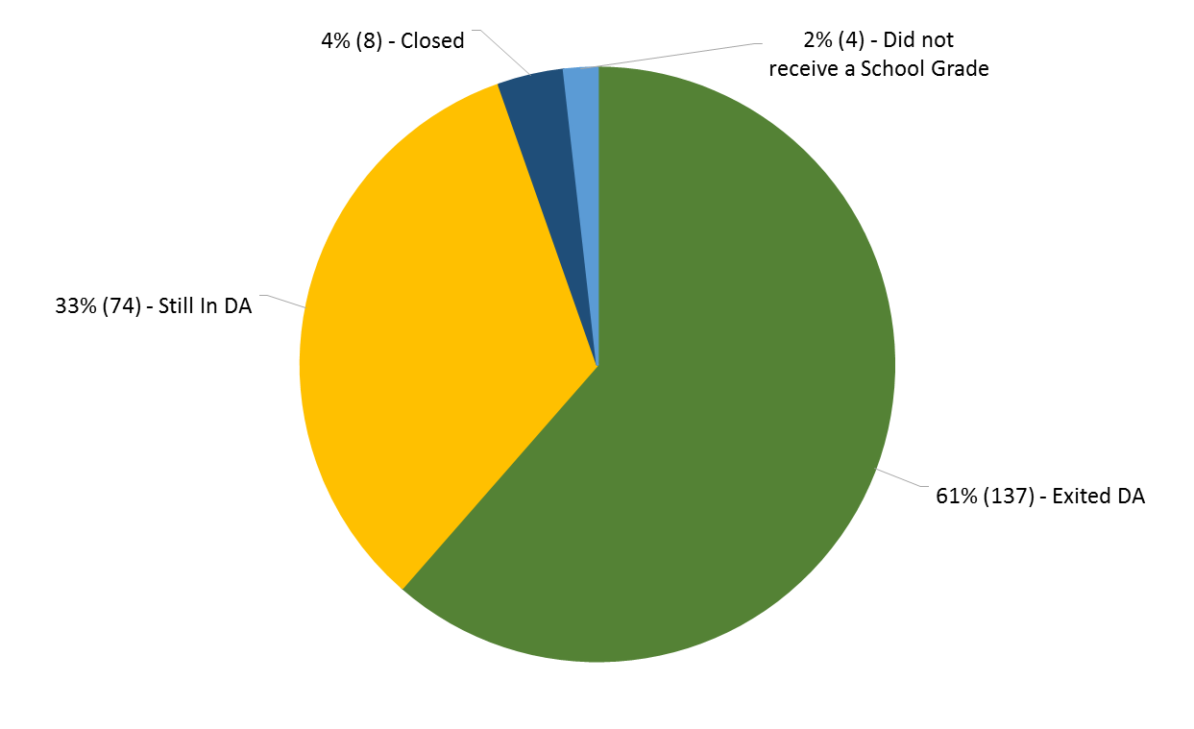
2017-2018 DA Schools, where are they now?

Slide 6
2018-19 BSI Team Goal
If we implement our Bureau of School Improvement mission and vision with fidelity, then 67% of Differentiated Accountability (DA) schools will increase their school grade in 2019.

Slide 7
Changes to School Improvement Rule

Slide 8
Proposed Changes
The proposed rule:
Eliminates the state designation of TS&I and classifies all Differentiated Accountability (DA) schools as CS&I;
Renames DA;
Adds a form to notify and receive approval prior to the hiring of a turnaround principal and
Revises incorporated forms used by school districts.
Webinar- June 6 at 10:00 a.m.

Slide 9
Principal Change Form- submit to BSI no later than 10 days prior to the proposed principal hire date

Slide 10
2019-20 School Improvement Plan Updates
Notes:
A school is identified for Comprehensive Support & Improvement (CS&I) if it earns a D or F school grade, has an overall Federal Index of 40 percent or less, or has a graduation rate of 67 percent or lower.
A school that is not identified for CS&I, but has an underperforming subgroup (any subgroup with a Federal Index at or below 40 percent), is identified for Targeted Support & Improvement (TS&I).
The Florida Department of Education will provide support to school districts to reduce the achievement gap by increasing student achievement in CS&I and TS&I schools.

Slide 11
School Improvement Plan (SIP)
1001.42 (18)(a) F.S.
School improvement plans.—The district school board shall annually approve and require implementation of a new, amended, or continuation school improvement plan for each school in the district which has a school grade of “D” or “F”; has a significant gap in achievement on statewide, standardized assessments administered pursuant to s. 1008.22 by one or more student subgroups, as defined in the federal Elementary and Secondary Education Act (ESEA), 20 U.S.C. s. 6311(b)(2)(C)(v)(II);
Webinar- May 23 at 10:00 a.m.

Slide 12
Requirements for SIPs
The district shall annually approve a SIP for each school which:
Has a school grade of D or F
Has a significant gap in achievement on state assessments by one or more subgroups
Has not significantly increased the percentage of students passing state assessments
Has not significantly increased the percentage of students demonstrating learning gains or
Has significantly lower graduation rates for a subgroup when compared to the state’s graduation rate
1001.42 (18)(a) F.S.

Slide 13
Evolution of the SIP
In 2018-19, there were two options available in CIMS for the SIP.
Standard SIP (traditional format)
Pilot SIP (condensed, data-based format)
In 2019-20, there will be only one option.
Stakeholder input (internal, external)
SIP (condensed, practical, data-based format)
≈200 Users
≈2000 Users
Notes:
As you may recall, in 2018-19, there were two options available in CIMS for developing your SIP: the Standard SIP and the Pilot SIP. The Standard SIP was the traditional, lengthier version of the SIP that had been in use for several years. The Pilot SIP featured a more condensed, data-based format that was designed to create a more succinct School Improvement Plan.
In 2019-20, there will only one option for the SIP. Much like last year’s Pilot SIP, this year’s SIP follows a condensed, practical, data-based format.

Slide 14
2019-20 Schoolwide Improvement Plan
Created in collaboration with feedback from DA Team, Internal DOE partners, and districts.
Notable Changes:
DA and ESSA status will be listed on the demographics page
EWS systems page will include number of students by grade level and teachers at the school
School’s ESSA data will be included
Analysis questions revamped to provide deeper and more thought provoking reflection
Planning process revamped to include measureable outcomes and evidence-based strategies
Helpful links to the State, District, and School Report Card and the 2019-20 School Improvement Leadership Guide are included in the plan

Slide 15
Area of Focus
Rationale
Measureable Outcome
Evidence-based Strategy
Rationale for Evidence-based Strategy
Action Steps (numbered)
Notes:
The purpose of this section is to develop specific plans for addressing the school’s highest-priority needs by identifying the most important areas of focus. Identify the Areas of Focus based on any/all relevant school data sources, including the data from Section II.
Provide a Rationale for identifying this Area of Focus, include the data sources that helped to identify this need.
“State the measureable outcome the school plans to achieve” is a new section in the 19-20 SIP. In this section BSI is looking for tangible, data driven outcomes that we can use as targets throughout the school year to help show growth and development toward accomplishing those goals.
“Evidence based strategy” is also an update to the 18-19 template. This section should be used to detail the strategy your school plans to use to accomplish the measureable outcome described in the previous section.
“Action Steps” should be numbered to show clear, direct actions that will be taken achieve the goal.

Slide 16
Schoolwide Improvement Plan Resources
www.floridacims.org
School Improvement Leadership Guide
Webinar will be held on May 23, 10 AM and will be recorded and posted on CIMS for future use
Regional teams will facilitate district trainings
Exemplar SIPs for TS&I schools with underperforming subgroups of SWD or ELL

Slide 17
7070 Turnaround School Supplemental Services Allocation (TSSSA)

Slide 18
TSSSA Eligibility
Three criteria for eligibility:
A school that is implementing a district-managed turnaround plan.
A school that has earned three consecutive grades below a “C”.
(May be in Cycle 2 of turnaround with the grade history of FFD, FDF, FDD, FFF)
A school that has improved to a “C” and is no longer in turnaround status within the last two years.

Slide 19
TSSSA Timeline & Funding
Timeline
Districts should develop and submit a plan (including a budget) for implementation to its school board for approval no later than August 1st
Districts shall submit its approved plans to the commissioner no later than September 1st
Funding
Each school district’s allocation must be based on the unweighted FTE student enrollment at the eligible schools and a per-FTE funding amount of $500 or as provided by the General Appropriations Act. (list available)

Slide 20
TSSSA Service Models
Services may include, but are not limited to:
tutorial and after-school programs
student counseling
nutrition counseling
parental counseling
extended day and school year
In addition, services may include models that:
develop a culture that encourages students to complete high school and to attend college or career training
set high academic expectations
inspire character development
A school district may enter into a formal agreement with a nonprofit organization to implement an integrated support service model that provides wrap-around services, including, but not limited to:
health services
after-school programs
drug prevention programs
college and career readiness programs
food and clothing banks

Slide 21
TSSSA Plan Requirements
A plan, at a minimum, must:
Establish comprehensive support services that develop family and community partnerships
Establish clearly defines and measurable high academic and character standards
Increase parental involvement and engagement in the child’s education
Describe how instructional personnel will be identified, recruited, retained, and rewarded
Provide professional development that focuses on academic rigor, direct instruction, and creating high academic and character standards
Provide focused instruction to improve student academic proficiency, which may include instructional time beyond the normal school day or year
Include a strategy for continuing to provide services after the school is no longer in turnaround status by achieving a “C” or higher.

Slide 22
TSSSA Plans
Plan template will be provided to the district (similar to Traditional Schools of Hope application, TOP-3).
Plan requirements (services) and budgets will need to be identified by eligible school(s).
Award will be at the district level.

Slide 23
UniSIG Teacher Recruitment and Retention Allocation

Slide 24
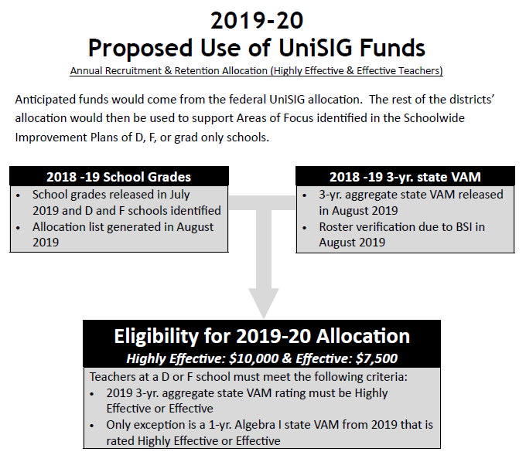

Slide 25
Important Dates

Slide 26
Important Dates – May and June
Schoolwide Improvement Plan webinar – May 23 at 10 a.m.
Heartland Leadership Conference – June 5, Lake Placid
School Improvement Rule webinar – June 6 at 10 a.m.
Summer Literacy Institute - June 11-13, Orlando
Sunshine State Scholars - June 13-14, Orlando
Instructional Leadership Team Academy (Institute II) - June 18-19, Orlando

Slide 27
Important Dates – July and August
Summer Science STEMposium
July 8-11, Tallahassee, July 15-18, Tampa, July 22-25, Palm Beach
NEFEC Leadership Conference - July 9-10, Sawgrass
NEFEC- SIP Training - July 11 (8:30-11 AM), Sawgrass
Florida Teacher of the Year Gala - July 18, Orlando
PAEC- Impact of ESSA & SIP - July 22 (1-4 PM), Destin
PAEC Leadership Conference- July 23-24, Destin
BSI Summer Academy (South) - July 23-24, Largo
BSI Summer Academy (North) - July 31-August 1, Ocala

Slide 28
BSI Timeline/Due Dates
May 1- External Operator Contracts due
May 24- 2019-20 SIP will be open in CIMS
July 17- State Board Meeting to approve 2019-20 TOP-2, Cycle 2 or 3 (External Operator) Plans
August 2- UniSIG application due in CIMS
September 1- TSSSA plan must be approved by the district school board, MOUs due, Instructional Rosters due for UniSIG Recruitment and Retention Allocation
October 1- TSSSA plan and TOP-2, Cycle 1 Plans due

Slide 30
Every Student Succeeds Act (ESSA)
Notes:
The Every Student Succeeds Act (also known as ESSA) is a bipartisan federal law that was signed in December 2015.
It amended the Elementary and Secondary Education Act of 1965, replacing No Child Left Behind provisions.
Each state had to submit a state plan detailing how it would comply with the new law.
With a strong, proven accountability system, Florida was already ahead of most of the nation as it relates to the requirements of ESSA.

Slide 31
New ESSA Accountability Provisions
Inclusion of English Language Learner (ELL) proficiency as a separate accountability indicator
Additional focus on reporting of subgroup performance
Additional federal school improvement designations and support
Revamped public report cards of state, district and school data
Notes:
4 key requirements to ESSA include:
the inclusion of ELL proficiency as an accountability indicator,
focus on subgroup performance,
adds the federal designations of CS&I and TS&I, as well as a tiering of support and
a new system of reporting state, district and school data.

Slide 32
Florida's ESSA State Plan
Drafted with public input, including workgroup of superintendents
Approved September 26, 2018
Preserves the focus on increased student achievement
No changes to Florida’s state accountability systems
School Grades
Differentiated Accountability
Adds a Federal calculation to satisfy ESSA requirements
New Federal Percent of Points Index (Federal Index)

Slide 33
New Federal Index
Calculation includes all school grades components plus English Language Proficiency (ELP) progress
English Language Proficiency progress – the percent of ELLs who make progress on the state’s assessment of proficiency in the English language (i.e., learning gains on ACCESS for ELLs or Alternate ACCESS for ELLs)
Calculated for all schools including ungraded, Exceptional Student Education centers, alternative schools, Department of Juvenile Justice facilities, and feeder schools
Calculated overall and by subgroup
Notes:
Calculation includes all school grades components plus English Language Proficiency progress
English Language Proficiency progress – the percent of ELLs who make progress on ACCESS for ELLs or Alternate ACCESS for ELLs
For ACCESS for ELLs
ELLs who increase their whole number composite proficiency level or
Remain at a composite score of 4, 5, or 6 and do not decrease a level
For Alternate ACCESS for ELLs
ELLs who increase their scoring category (Scale = A1, A2, A3, P1, P2, or P3)
Remain at a scoring category of P1 or above and do not decrease a level
Calculated for all schools including ESE, Alternative, and DJJ
K-3 schools that don’t receive their own index will receive the Federal percent of points index of the school to which a majority of their students matriculate, as is currently done for the school grade for school recognition purposes
Calculated overall and by subgroup
The new Federal Percent of Points Index calculation includes all school grade components plus English Language Proficiency progress. This is the percent of English Language Learners who make progress on the assessment called ACCESS for ELLs or alternate ACCESS for ELLs.
The Federal Percent of Points will be calculated for all schools including ESE, Alternative, and DJJ and feeder schools.
This calculation will produce an overall school Federal Percent of Points and a measure for each of the ten subgroups. This calculation is in addition to school grades, but does not replace it. It is another piece of information that will help us focus our improvement efforts.
NOTES
For ACCESS for ELLs
ELLs who increase their whole number composite proficiency level or remain at a composite score of 4, 5, or 6 and do not decrease a level
For Alternate ACCESS for ELLs who increase their scoring category (Scale = A1, A2, A3, P1, P2, or P3) remain at a scoring category of P1 or above and do not decrease a level
K-3 schools that don’t receive their own index will receive the Federal percent of points index of the school to which a majority of their students matriculate, as is currently done for the school grade for school recognition purposes

Slide 34
Federal Index
ESSA Indicator | Florida Component
Academic Achievement – including Student Growth | English Language Arts (ELA) Achievement
 | Mathematics Achievement
 | Learning Gains ELA
 | Learning Gains Mathematics
 | Learning Gains Lowest 25% ELA
 | Learning Gains Lowest 25% Mathematics
Graduation Rate | 4-Year Graduation Rate
School Quality or Student Success | Science
 | Social Studies
 | Middle School – Acceleration
 | High School – College and Career Acceleration
Progress in Achieving English Language Proficiency (ELP) | ELP Progress
Notes:
On the left of this chart is the list of ESSA indicators aligned to the list on the right of the Florida components that comprise the Federal Percent of Points Index. The highlighted area is new.

Slide 35
Federal Index Calculated for 10 Subgroups
7 major racial and ethnic groups (White, Black, Hispanic, Asian, Native Hawaiian or other Pacific Islander, American Indian or Alaska native, and two or more races)
Students with disabilities (SWDs)
English Language Learners (ELLs)
Economically disadvantaged students
Notes:
The Federal Percent of Points Index will measure the performance of these ten subgroups:
Economically disadvantaged students
Major racial and ethnic groups (White, Black, Hispanic, Asian, Native Hawaiian or other Pacific Islander, American Indian or Alaska native, and two or more races)
Students with disabilities and
English Language Learners (ELLs)

Slide 36
Summary of the 2017-18 Baseline Data
A total of 553 schools are identified for Comprehensive Support and Improvement (CS&I)
This includes Florida’s D&F schools (230 schools)
The rigor of Florida’s current School Grades system is evidenced by the reality that 51 D schools identified here would be unidentified if we solely relied on the Federal Index
Over half of the 553 schools (299) are ungraded schools, providing an opportunity to engage stakeholders for these alternative, ESE, and DJJ schools

Slide 37
Summary of the 2017-18 Baseline Data
A total of 1,952 higher-performing schools are identified for Targeted Support and Improvement (TS&I) to address pockets of performance problems with specific student subgroups
This stresses the need to be innovative in even our high-performing schools to address the outcomes of all students, particularly students with special needs
Over half (55%) of the schools identified for TS&I have only one subgroup identified, and the vast majority (96%) have three or fewer subgroups identified

Slide 38
State, District, and School Report Cards
EduData- new interactive report card which provides the federally required components for the state, district, and school report cards https://edudata.fldoe.org/
Includes the information accessed through SPARS in a more accessible format for parents and the general public
Includes the following:
School grade and school grade components, and Federal Index
Components disaggregated by subgroup
State, District, School level
English Language Proficiency Progress
State, District, School level
Whether the school is identified for support
Notes:
http://edudata.fldoe.org- released February 27, 2019
The report cards serve as a valuable resource by offering greater transparency into how the state, districts and schools are doing with regards to student achievement and success, including student sub-group data.

Slide 39
School Improvement Categories
Will be identified on new report cards
Federal Comprehensive Support and Improvement (CS&I) for DA Schools/Current State CS&I and TS&I
NEW Federal Comprehensive Support and Improvement (CS&I) Based on 2017-18 performance
NEW Federal Targeted Support and Improvement (TS&I) Based on 2017-18 performance
Current grade “D” | Differentiated Accountability (DA) Support
Current grade “F” | DA Support
Not “D” or “F” but graduation rate 67% or lower | DA Support
Not “D” or “F” but overall Federal Index of 40% or lower | Tiered Support
A TS&I school with a subgroup Federal percent of points index 40% or lower for 6 years* (2023-24) | Tiered Support
Any subgroup performance on Federal Index of 40% or lower in the current year *moves to CS&I after 6 years | Tiered Support
Any subgroup performance on Federal Index of 31% or lower for 3 consecutive years (2020-21) | Tiered Support

Slide 40
Federal ESSA Category: Targeted Support and Improvement (TS&I)
 | State Support Provided | Required District Action | Performance based on | Timeline for Support
1. NEW Annually, any SUBGROUP with a Federal Index of 40% or lower After 6 years, same SUBGROUP, school moves to CS&I | Tiered Support- by subgroup(s) | School Improvement Plan targeting subgroup(s) as Area of Focus | *2018-19 | 2019-20
2. NEW After 3 years, same SUBGROUP with a Federal Index of 31% or lower | Tiered Support- by subgroup(s) | School Improvement Plan targeting subgroup(s) as Area of Focus | 2017-18 through 2019-20 | 2020-21
*2017-18 ESSA Report Card is baseline data

Slide 41
ESSA Category: Comprehensive Support and Improvement (CS&I)
 | State Support Provided | Required District Action | Performance based on | Timeline for Support
1. NEW Annually, OVERALL SCHOOL Federal Index of 40% or lower All school grade components + ELP progress | Tiered Support | School Improvement Plan | *2018-19 | 2019-20
2. NEW After 6 years, a TS&I school with the same SUBGROUP with a Federal Index of 40% or lower moves to CS&I | Tiered Support- by subgroup(s) | School Improvement Plan targeting subgroup(s) as Area of Focus | 2017-18 through 2022-23 | 2023-24
3. Current State DA Grade of “D” or “F” for graded schools with graduation rates of 67% or lower | DA Regional Teams | School Improvement Plan DA Rule | 2017-18 | 2018-19
*2017-18 ESSA Report Card is baseline data

Slide 42
Federal TS&I Tiered Support for Schools (not in DA)
Identification Based on Federal Index
CS&I
Tier 3
TS&I
Tier 1
Universal Supports
TS&I
Tier 2
Supplemental Supports
NEW Federal law requires all identified schools to do a Schoolwide Improvement Plan (beginning in 2019-20)
Annual OVERALL school Federal Index (40% or lower) 2019-20
6 years of same low subgroup (40% or lower) 2023-24
Intensive Supports
3 years of same low subgroup (31% or lower) 2020-21
Annual low subgroup (40% or lower) 2019-20
* Tiering requirements escalate
Notes:
All identified schools must do an improvement plan (SIP).
Tier 1 begins in year 1 and will look a lot like the Tier 1 support of the past few years. The difference is that support will be provided to all districts with an identified school, instead of those requesting it.
Universal Supports (Tier 1, TS&I, Years 1-3)
General, statewide support designed to inform, assist and improve results, including:
Technical Assistance and Professional Development
Size-alike or issue-alike problem-solving groups
Access to posted resources
Best Practices for Inclusive Education assessment/plan
District ELL plan, K-12 Reading Plan
Directors’ conference calls
NEW: FDOE/LEA ensures improvement plans are completed, there is focus on affected subgroups, and there is alignment to resources and professional development opportunities
Tier 2 kicks in after 3 years of having an underperforming subgroup.
Supplemental Supports (Tier 2, TS&I, Years 4-6)
More focused, targeted, frequent support in addition to and aligned with universal supports that are provided in response to identified needs, including:
Targeted assistance in specific indicators from FDOE staff and partners
Work with district- and school-based leaders
Program area staff specialization and regular district contact call targeted to need
NEW: Desktop monitoring of improvement plans, with district conference calls on how identified schools are accessing and using resources to improve subgroup performance
There are two ways to get Tier 3 support. One, it begins after 6 years of having an underperforming subgroup. And 2, Tier 3 begins right away if a school has an overall federal percent of points of 40% or below. Remember that the federal percent of points includes school grades components plus an English Language Proficiency progress component, divided by the number of components of that school.
Intensive Supports (Tier 3, CS&I)
Most focused, targeted, frequent support in addition to and aligned with universal and supplemental supports, including:
More frequent desktop support to monitor district progress
Individualized, targeted attention and assistance from FDOE staff and partners based on need
NEW: Onsite monitoring of improvement plans at identified schools to ensure use of resources and best practices, and review prioritization of federal funds at the district level

Slide 43
Tiered Support for Schools not in DA
Identification Based on Federal Index
CS&I
Tier 3
Intensive
Supports
TS&I
Tier 1
Universal Supports
TS&I
Tier 2
Supplemental Supports
4 Schools
Annual OVERALL school Federal Index (40% or lower) 2019-20
6 years of same low subgroup (40% or lower) 2023-24
3 years of same low subgroup (31% or lower) 2020-21
1,952 Schools
Annual low subgroup Federal Index (40% or lower) 2019-20

Slide 44
Tiers of Support to
CS&I Low-performing Schools-
3 options for
Turnaround Plan-
close, charter, or
external operator
School Improvement Plan
(annual plan)
Regional Team works with district and school leadership teams
Instructional Reviews
District-managed Turnaround Plan
(2-year plan)
Submit Quarterly Data
Tier 3
Tier 2
Tier 1
* Tiering requirements escalate
Notes:
This slide shows the tiers of support provided to DA schools based on their 2018 school grade.
DA support is intended to build capacity by focusing on systems and structures needed to accelerate and sustain school improvement. Support is provided by our regional school improvement teams in consultation with the district to determine local needs. This support typically includes facilitation of collaborative processes such as data and risk analyses, needs assessment, strategic planning and problem solving, performance management, professional development, and cross-district networking to share promising practices and lessons learned.
The regional teams review, provide feedback, and monitor progress on the implementation of school improvement plans and turnaround option plans.
Tier 1 – There are currently 115 schools that receive tier 1 support. This number consists of 106 first time D’s, 8 grad-only schools, and 1 school with an Incomplete.
Tier 1 consists of the following interventions:
Completion of a School Improvement Plan which details school-based interventions.
Monthly visits by our regional teams to monitor schools and districts.
Instructional Reviews are conducted multiple times throughout the year.
Memorandum of Understanding (MOU) as previously discussed.
In addition, DA schools qualify for Title I, Part A School Improvement funds to support strategies identified in the School Improvement Plan.
Tier 2 – There are currently 74 district-managed turnaround schools that receive tier 2 support. These schools receive tier 1 support as well as the following additional interventions for tier 2:
Completion of a Turnaround Option Plan; typically, district-managed turnaround is selected as the first option.
Verification of instructional personnel's state VAM.
Quarterly submission of teacher and student data to the Department.
Bi-weekly visits by our regional teams to monitor schools and districts.
Tier 3 –There are currently 14 schools that receive tier 3 support. These schools still receive tier 1 and tier 2 support, as well as the following additional interventions for tier 3:
Completion of a Turnaround Option Plan for the next cycle of turnaround implementation.
Weekly contacts by our regional teams to monitor schools and districts.
Visit by the Chancellor or Executive Director of School Improvement.

Slide 45
Turnaround Option Plan (TOP) Timeline

